Slide 1

Shocker Track Club
Youth Track & Field Team
The College Recruiting Process
for High School Athletes and Parents

Slide 2
Added here 3/27/2025
View the number of cross country and track scholarships available by division level and see if you meet the women's track and field scholarship standards. Source: NCSA College Recruiting https://search.app/2gaQF1dEHdzJ7HyP9

Slide 3
SHOCKER TRACK CLUB
Mission
The Shocker Track Club, Inc., (STC) is a 501(C)(3) organization that helps support Wichita State University Track & Field, Friends University Track & Field, and Wichita area Track and Field club activities.

Slide 4
STC Recruiting Connections
Strong connections to:
Wichita State University, Friends University, Washburn University, Ottawa University, Emporia State University, Hutchinson Community College, Graceland University, US Army-West Point Military Academy, Towson University, High Point University, University of Nebraska, and Kansas State University
Presentations by Wichita State University on the college recruiting and team membership
Practice visits by various colleges and universities

Slide 5
STC University Connections
Indoor Track Meets
Coaching Staff
Wichita State University
Wichita, Kansas
Pittsburg State University
Pittsburg, Kansas
University of Kansas
Lawrence, Kansas
Washburn University
Topeka, Kansas
Friends University
Wichita, Kansas
Wichita State University
Wichita, Kansas
High Point University
High Point, North Carolina
University of Nebraska
Lincoln, Nebraska
Emporia State University
Emporia, Kansas
Washburn University
Topeka, Kansas
Pittsburg State University
Pittsburg, Kansas
Friends University
Wichita, Kansas
Ottawa University
Ottawa, Kansas
West Point US Military Academy
West Point, New York
Towson University
Baltimore, Maryland
Hutchinson Community College
Hutchinson, Kansas

Slide 6
How STC Can Assist
Mention Athlete names to colleges/universities
Mention Athletes on social media
Provide general information about colleges
Host visits by college Coaches
Offer general opinions about various colleges

Slide 7
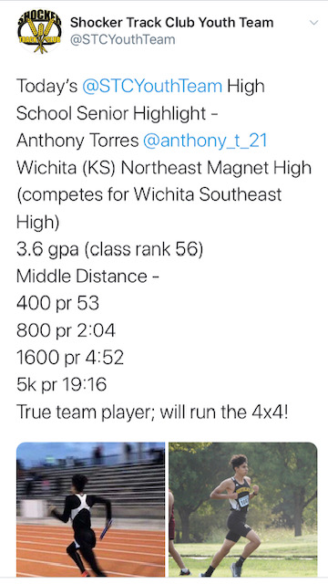
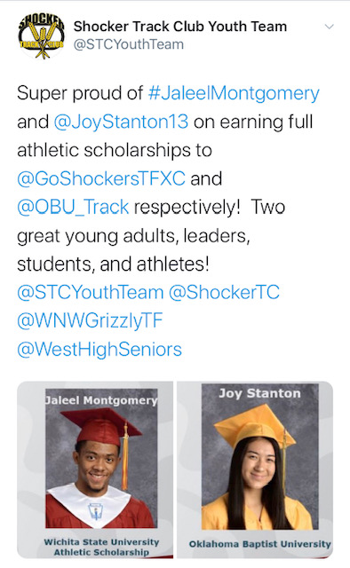
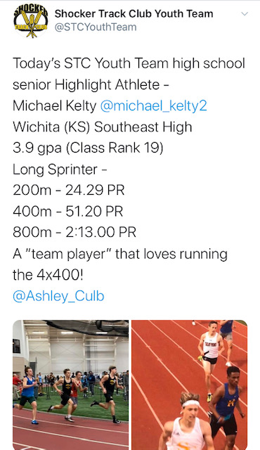
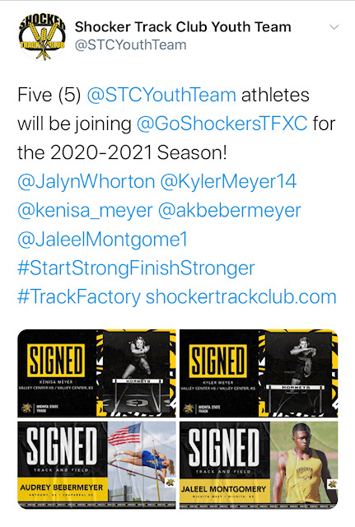
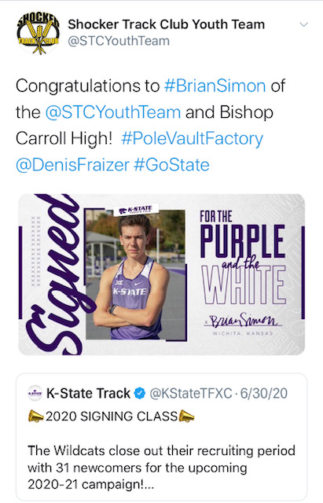
STC Social Media

Slide 8


Early Recruiting Process
Account established with NCSA – Next College Student Athlete -
NCSA is the “official recruiting partner” of USA Track & Field
Get more exposure for athletes
NCSA provides the following -
View athletes' recruiting activity, and make evaluations and recommendations
Access to virtually every college coach
Information on every NCAA, NAIA and junior college program
FREE Athlete profile and college search
Links >>
https://www.ncsasports.org/team
https://team.ncsasports.org/teams/shocker-track-club-inc/sign_up

Slide 9
Letters of Intent 2025-2026
ATHLETE | HIGH SCHOOL | UNIVERSITY
Ellie Petz | Central Christian Academy | Friends University
Rylee Wooten | Rose Hill High School | Emporia State University
Ava Luna | Garden City High School | Drury University

Slide 10
Letters of Intent 2024-2025
ATHLETE | HIGH SCHOOL | UNIVERSITY
Madison Williams | Clearwater High | Pittsburg State University
Jack Harty | Wichita Heights High | Emporia State University
Katelyn Nichols | Inman High | Oral Roberts University
Liberty Smith | Derby High | Friends University
Evan Benoit | Wichita East High | Emporia State University
Benn Schnelle | Derby High | Mid America Nazarene
Trey Bias | Rose Hill High | Oral Roberts University
Trey Kelly | Andover Central High | Oral Roberts University
Mackenzie Sauerwein | Newton High | Emporia State University
Piper Hula | Derby High | Pittsburg State University
Madison Locke | Wichita Northwest High | Fort Hays State University
Jackson Salsbury | Maize High School | Pittsburg State University
Fardis Hossinei | Derby High School | Mid America Nazarene
Logan Barnhill | Wichita Heights High | Friends University
Tristen Cross | Wichita East High | Wichita State University

Slide 11
Letters of Intent 2023-2024
ATHLETE | HIGH SCHOOL | UNIVERSITY
Bryce Barkdull | Andover Central High | University of Kansas
Lanie Page | Rose Hill High | Fort Hays State University
Faith Ekart | Sterling High | Wichita State University
Adryana Shelby | Wichita Northwest High | University of New Mexico
McKinlee Walker | Andover High | Pittsburg State University
Bre’Ana Tillemans | Haysville-Campus High | Missouri State University
Karynne David | Wichita Heights High | Iowa State University
Ryan Son | Wichita East High | Columbia University
Rylan White | Andale High School | Fort Hays State University
Owen Lang | Andover Central High | United States Military Academy West Point
Gabrielle Newell | Marion High School | Bethany College
Laurens van Schaik | Life Prep Academy | Grand Canyon University
Olivia Leatherman | Wichita Northwest High | Friends University
Jesus Bey | Derby High School | Friends University
Jaden Harris | Derby High School | Friends University
Spencer Rich | Maize South High School | Fort Hays State University
Bryce Schwerdtfeger | Goddard High School | Washburn University
Elizabeth Brozek | Wichita Heights High | Cowley County Community College

Slide 12
Questions
?
?
?
?

Slide 13
2025-2026 collegiate recruiting cycle
Shocker Track Club Youth Team

Slide 14
2025-2026 Recruiting Cycle
The Agreement Settlement –
Sets new limits for the maximum roster size of every Division I NCAA-sponsored sport, reducing D-I opportunities by at least 4,739 if the settlement is approved.
Settlements remain in discussion
Schools are reacting to proposed changes
Schools were allowed to keep Walk-on Athletes!
New maximum roster size for many sports are smaller than the current average roster in those sports -
A handful of sports, including Track and Field would be disproportionately affected.
Reductions already have forced many coaches to renege on verbal promises they made despite the pending uncertainty about roster sizes.

Slide 15
2025-2026 Recruiting Cycle
Expected NCAA Changes for D1 Schools -
Elimination of National Letter of Intent Program
Proposed roster size limitations w/increases in scholarship opportunities
Track & Field will have 45 Roster and Scholarships
Previously 12.6 for Men and 18 for Women
Example D1 School - 63 Women/50 Men
Title IX governs Women’s Roster Size
Full implementation in 2024-2025 for 2025-26 year.
Athlete “movement”(Transfer Portal) –
beginning in December 2024
Additional in February/March 2025
Significant Transfers beginning May/June 2025
Roster Reductions and Finalization in Summer 2025

Slide 16
2025-2026 Recruiting Cycle
The “proposed” limits for track are 45 roster spots and 45 scholarships which doesn’t mean schools will have that many - most will not.
D1 schools will presume that the "proposed" limits will be finalized and thus build their roster plans based upon that.
There isn’t a date where rosters must be set/finalized
Example D1 School – “We assume we’ll have 45 women and less men because of title IX. We’ve always been about 10 more women.”
“We have 46 women coming back next year - obviously that means we’ll have to make cuts on both sides.”

Slide 17
What’s Maybe Going to Happen
D1 Schools
Plan for 45 Member rosters
WSU-50/KSU-31/KU-59/Nebraska-53/OU-40
Rank their current rosters in preparation for cuts
Sign “A-List” high school athletes
Wait for Portal to sign other athletes
D2 Schools -
Sign “their A-List” high school athletes
Wait…
NAIA Schools –
Sign “their A-List high school athletes
Wait…

Slide 18
2025-2026 Recruiting Cycle
Parity across College type is imminent -
Nearly every D1 school will have to reduce their rosters
Some athletes will leave voluntarily
Coaches will make roster reductions
There will be “trickle-across” amongst the Power 5 Conference Schools and certain other D1 schools.
There will be trickle-down” from the Power 5 Conference Schools to certain other D1 schools to remaining D1 schools
Some D1 schools will significantly strengthen their rosters
D2 schools will become very strong
NAIA schools will strengthen
Junior Colleges will become significant development programs

Slide 19
2025-2026 Recruiting Cycle
How High School Athletes are affected -
A+ Listers –
If currently unsigned look for the best option
A Listers –
If currently unsigned remain patient
B Listers –
Look at other options
Late Bloomers
If unsigned remain patient

Slide 20
2025-2026 Recruiting Cycle
What this means –
D1 Offers should be respected and highly valued
Probable limited opportunities at D1 Power 4 Conference Schools
Probable limited opportunities at “next tier” D1 conference schools and other D1 Schools
Best opportunities at D2 and NAIA Schools
Junior College offers should be considered

Slide 21
Recommendations For Athletes
Make School Connections NOW!
Be Open-Minded
Focus on Educational Goals
Be Patient
Stay positive
Consider D2, NAIA, and Junior Colleges
Be Flexible – You DO have options!

Slide 22
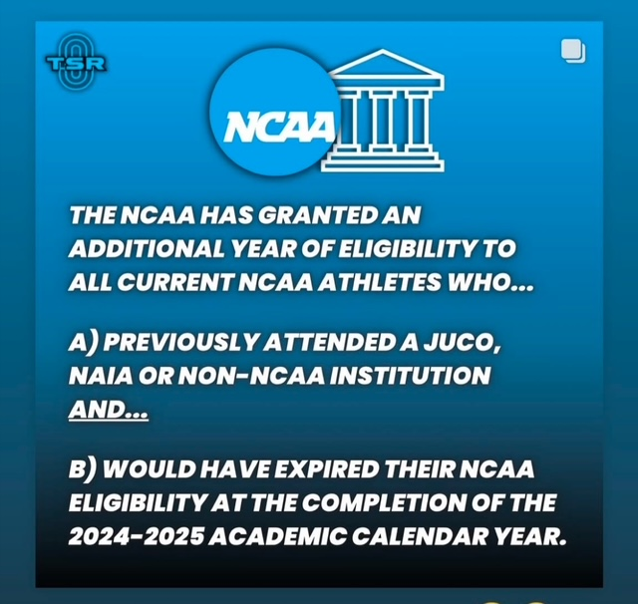
NJCAA and NCAA Issues

Slide 23
Decision Making Process
University Preference
Major Educational Preference
Athletics Preference and Goals

Slide 24
Questions
?
?
?
?

Slide 25
RECRUITING AND COLLEGE
Shocker Track Club Youth Team

Slide 26

Education First…
Participating in college athletics is a means to an end.
What are you interested in studying in college?
What do you want to do after you graduate from college?
Colleges provide tremendous support for athletes.

Slide 27
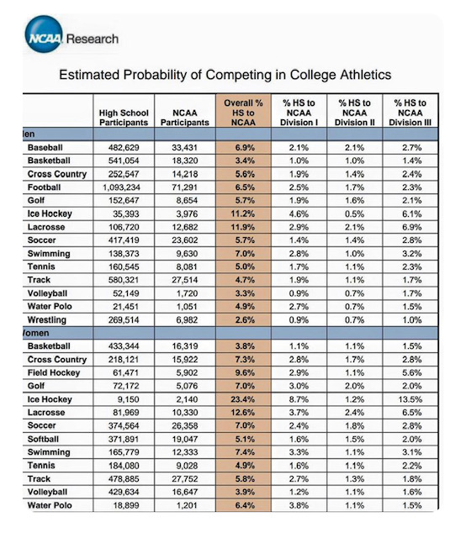
… and Last
Becoming a Collegiate Student Athlete is a Special Opportunity and a Privilege.

Slide 28
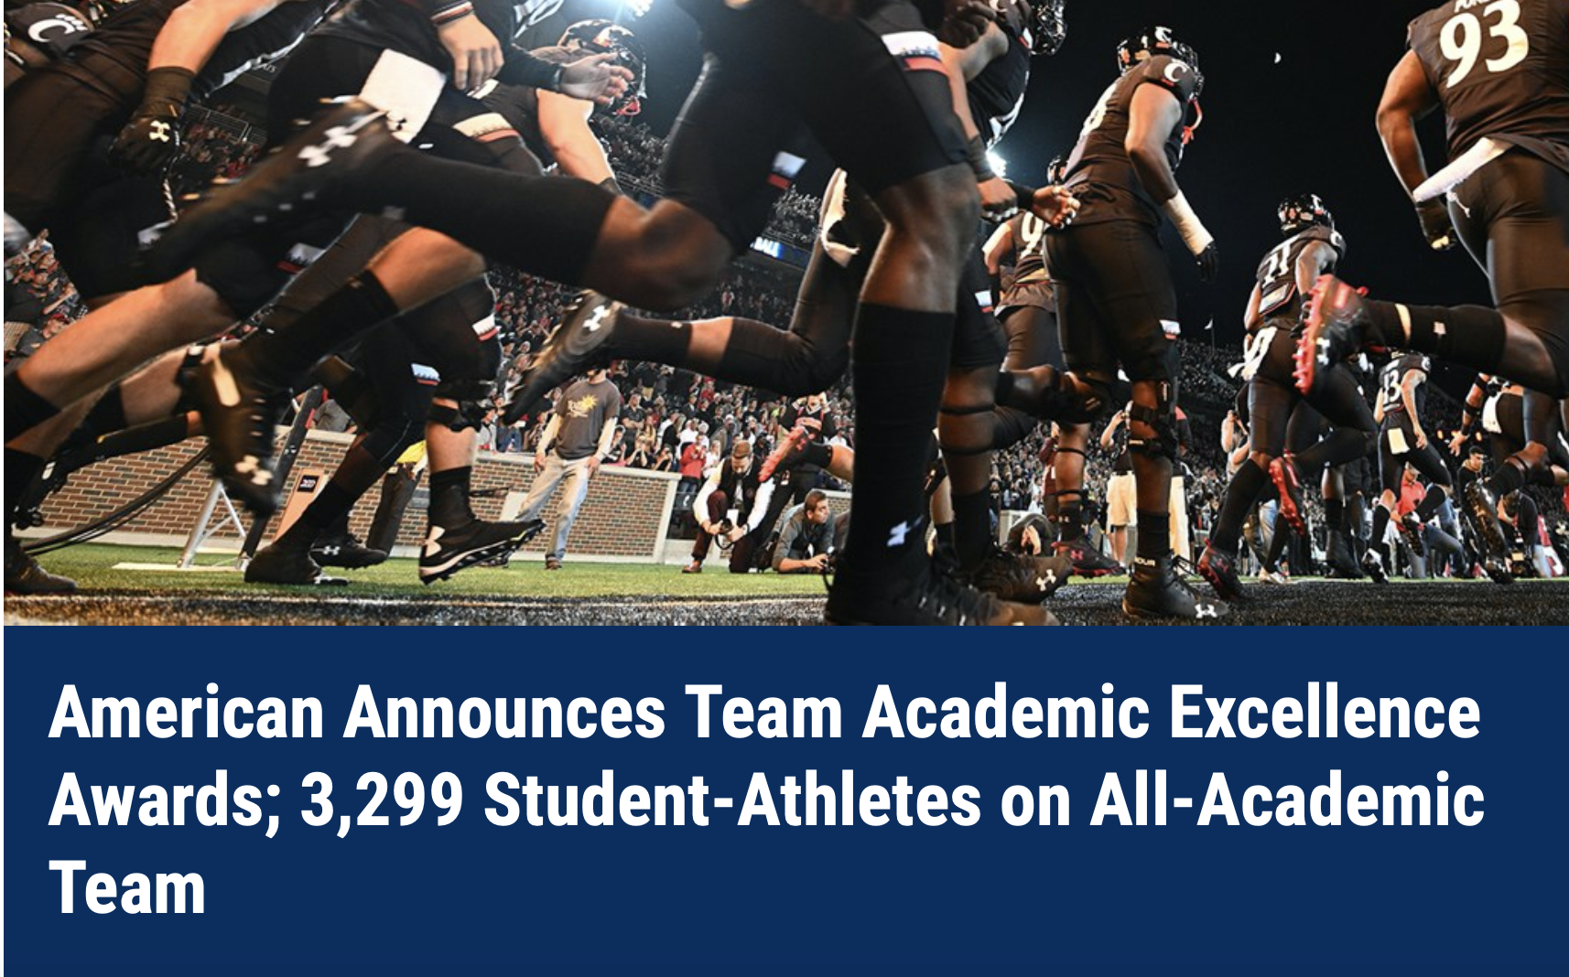
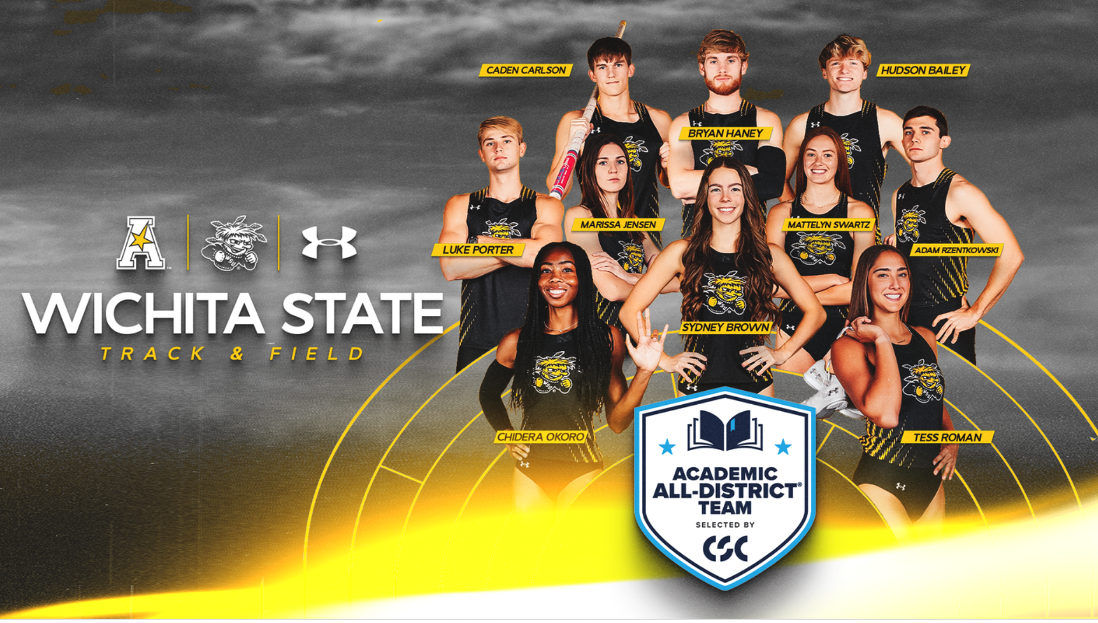
NCAA Requirements…
Colleges/Universities track academic progress of ALL athletes!
American Athletic Team Academic Excellence
Wichita State University Academic Excellence

Slide 29

Other Requirements
CollegeEligibilityRequirementsperKSHSAA

Slide 30
Academic Requirements ..
In general, the following is required for admittance to a NCAA Division 1 University –
16 Core Courses -
4 years of English
3 years of Math (Algebra 1 or Higher)
2 years of natural of physical science
(including one year of lab science)
1 year (extra) of English, Math or natural or physical science
2 years of social science
4 years of extra core courses
(from any category above)
Social Sciences
Foreign Language
Minimum GPA
Standardized Test Score - ACT or SAT

Slide 31
Things to Consider…
For colleges without football – the Track and Field Team is typically the largest athletic team on campus
Some scholarships are based upon ability to score at conference meets
Athletes competing in Track & Field AND Cross-Country sometimes earn more scholarship benefits
Redshirting can be good
NCAA D3 schools and Ivy League D1 schools do not offer athletic scholarships
Not all Track & Field athletes receive full scholarships

Slide 32
Scholarships Available…
Men’s T&F programs have fully funded -
NCAA D1 schools have 45 12.6 scholarships
NCAA D2 schools have 12.6 scholarships
NAIA programs have 12 scholarships
Women’s T&F programs have fully funded -
NCAA D1 schools have 45 18 scholarships
NCAA D2 schools have 12.6 scholarships
NAIA programs have 12 scholarships

Slide 33
Collegiate Athletes …
Scholarship Athletes may or typically receive –
Tuition and Books
Room and Board
Meals (Training Table)
Uniforms and Training Gear
Training in their sport/event
Access to Trainers
Weight and Physical Development Training
Study Hall and Tutoring and Academic Advising
Opportunities to perform community service
Connections for the future
Athletic knowledge base for future use

Slide 34
Collegiate Athletes …
Scholarship Athletes may or typically receive –
Tuition and Books
Room and Board
Meals (Training Table)
Training in their sport/event
Access to Trainers
Weight and Physical Development Training
Study Hall and Tutoring
Opportunities to perform community service
Connections for the future
Athletic knowledge base for future use
LIFE and PROFESSIONAL SKILLS!

Slide 35
Alternative Money…
Alston Educational Funds
Up to $5980 annually
Academic bonuses that are “rewards” for meeting academic performance goals in an amount equivalent to athletic achievement bonuses.
N(ame) I(mage) L(ikeness)….
Collectives…
Typically Non-Profit Organizations that facilitate programs
University Sponsored…
“Available” through a school’s Athletic Department
Not all universities have them
Opendorse is an example

Slide 36
College Coaches Look For..
Verifiable times or marks
Diversity in events
Multi-Sport Athletes
Involvement in school and community activities
“Clean” social media accounts
Great students – Leaders!

Slide 37
Athletic Standard Marks ..
Consider the following …
Men’s -
NCSA Men's T&F Standards by Division
Women’s –
NCSA Women's T&F Standards by Division
NCAA D1 National Championship Meet Standards are considerably tougher to meet.
Check https://www.tfrrs.org
Current Results for Indoor and Outdoor T&F

Slide 38
Sample Standard Marks ..

Slide 39
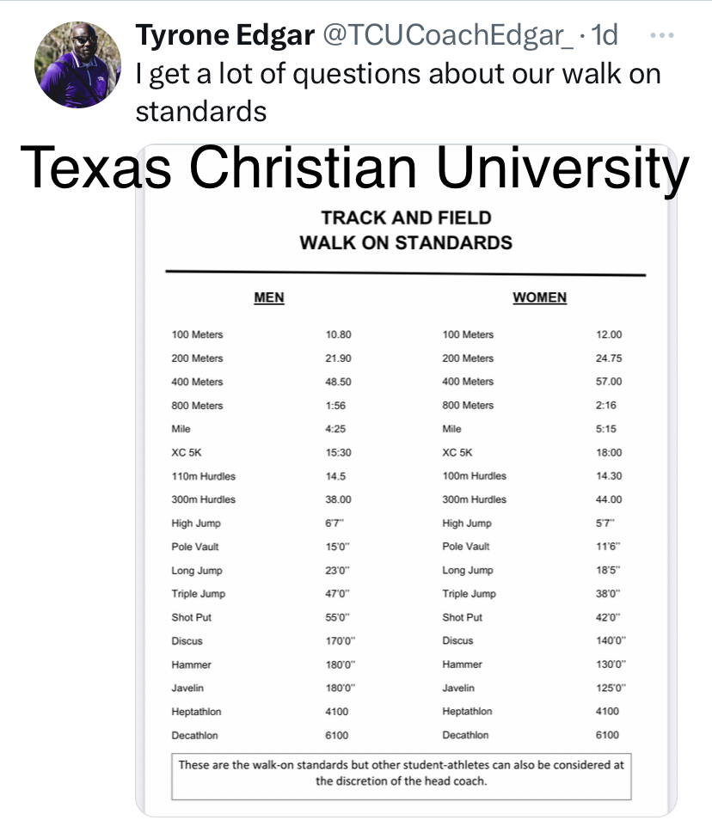
Sample Standard Marks ..

Slide 40

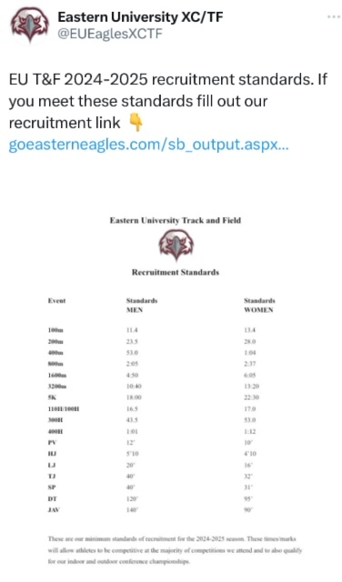

Sample Standard Marks ..

Slide 41

What You Can Do…
Visit your high school CCC Representative
Register at NCAA Eligibility Center
Complete University Online Questionnaires
Wichita State T&F Questionnaire - Women Wichita State T&F Questionnaire - Men
Keep Track of -
Athletics achievements - Resume
Classroom achievements
Community work
Research Universities AND Athletics teams online
Follow Coaches and athletes on social media
Take visits to campuses
Send emails to college Coaches
Be Patient!

Slide 42
… and also do this…
Consider ALL Athletic Divisions
(e.g., NCAA D1, D2, D3, NAIA, Junior College)
Have Transcripts available
Complete FAFSA
Take SAT/ACT Prep Courses
Take Care of Your Business
Be Patient!

Slide 43
… and do this…
www.trackr.run
Be Patient!

Slide 44
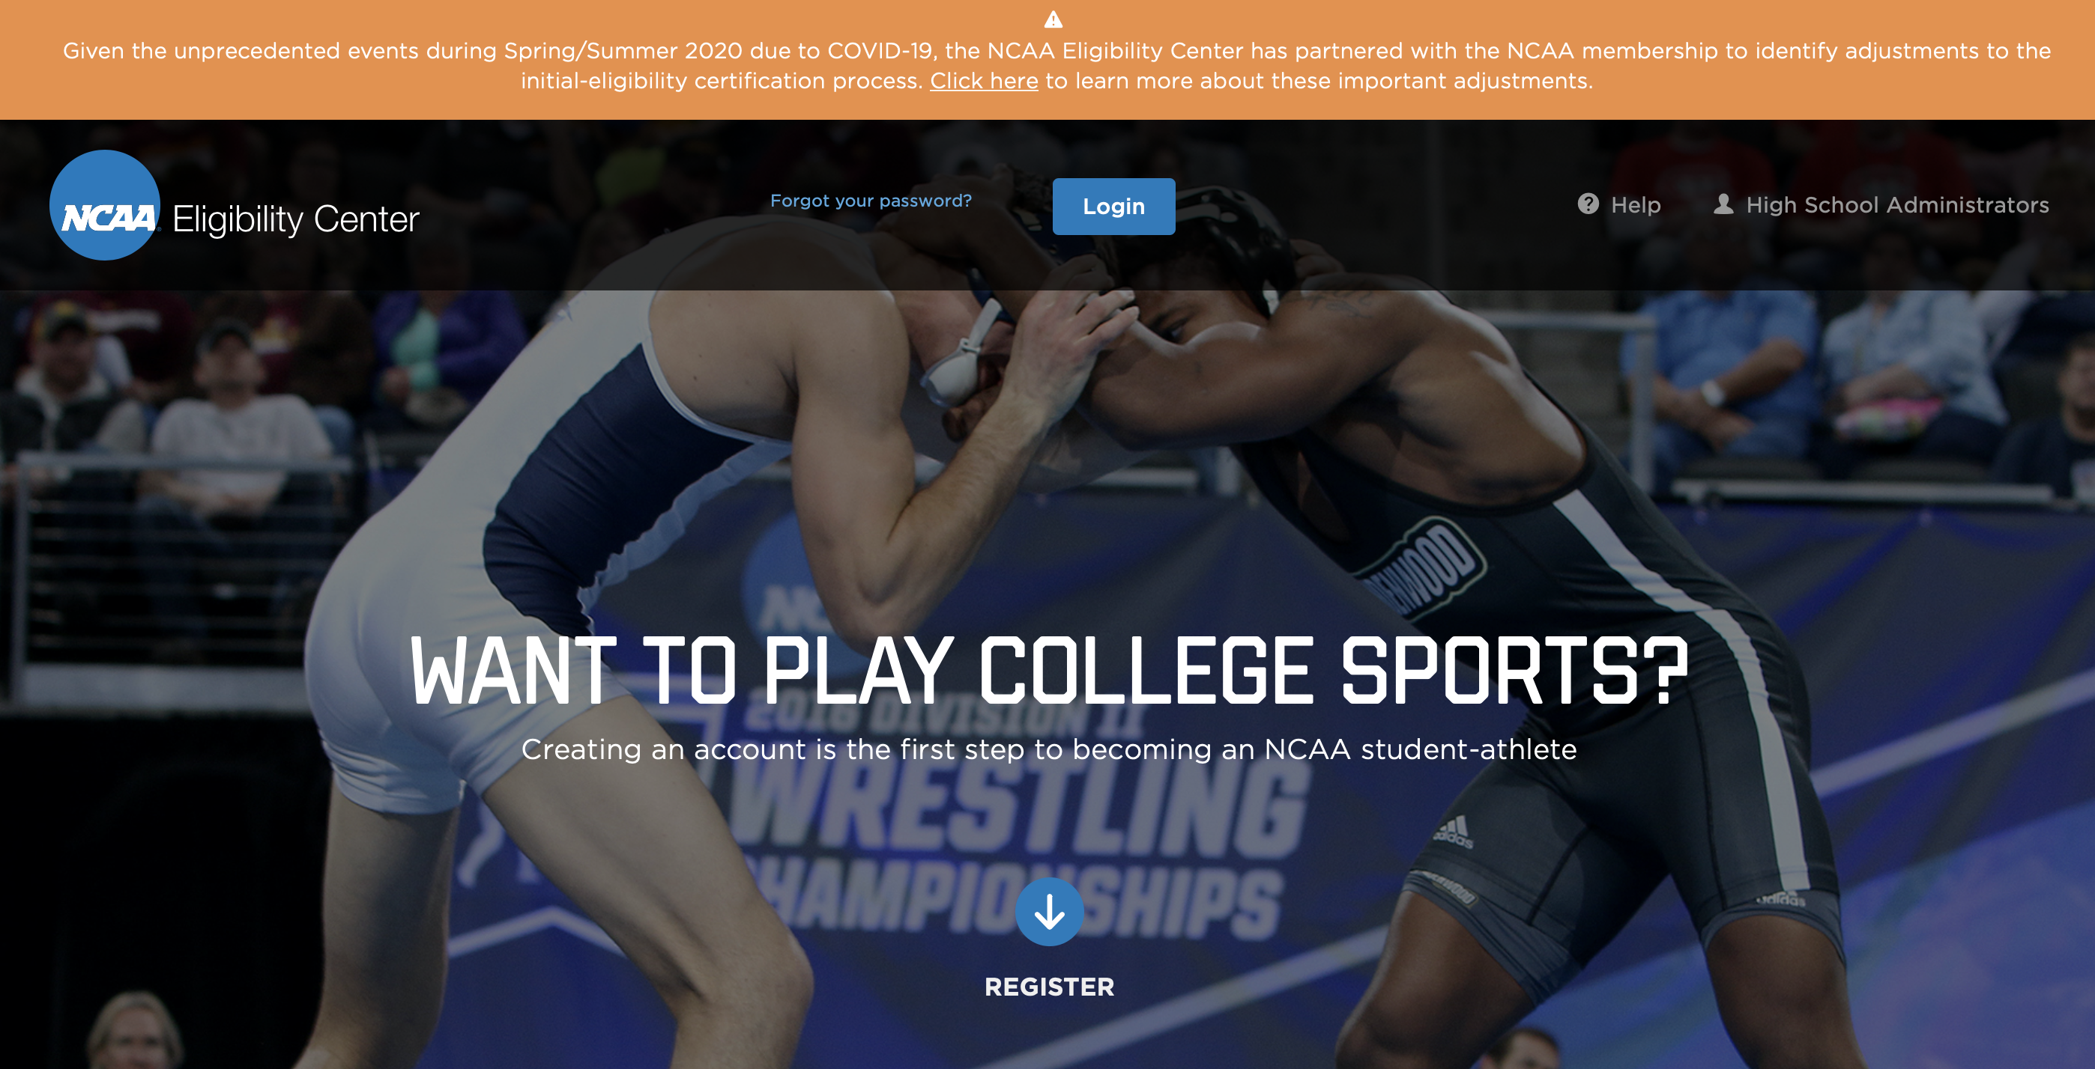
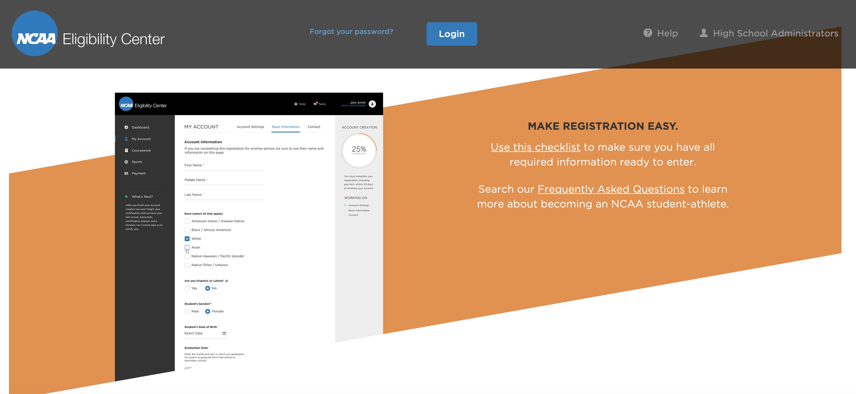
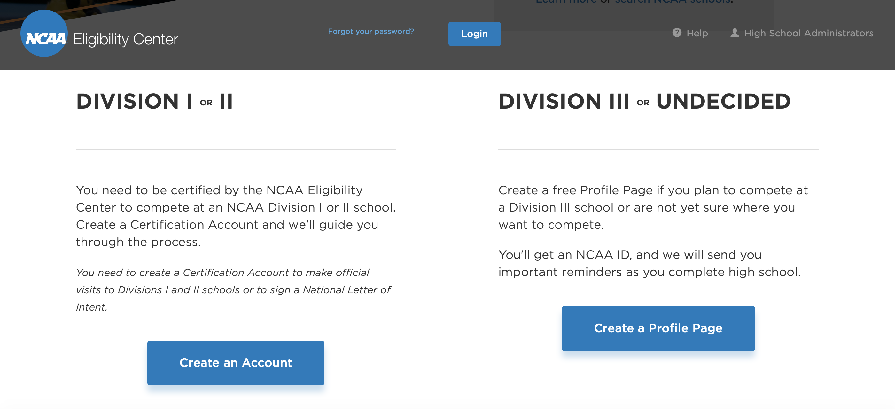
NCAA Eligibility Center
Want To Compete in Track and Field in College?
GET REGISTERED NOW!
NCAA Eligibility Center

Slide 45
FAFSA
Free Application for Federal Student Aid
New Forms for 2024
Complete FAFSA Information
Instructional Video for 2024-2025
The Hill Article about FAFSA

Slide 46
Scheduling College Visits
Informal Visits -
You can take as many as you want
Contact the Admissions Department
Feel free to email Coaches to let them know
Try to observe a practice
Formal Visits –
Typically arranged by Coaching staff
Be open-minded about your expectations
Ask about Study Hall and Tutoring
Be Patient!

Slide 47
What Should Parents Do…
Plan for campus visits
Research Universities AND Athletics teams online
Make certain your child registers for the NCAA Clearinghouse
Review University Guides for Student-Athlete Parents
Review “NCAA Guide for the College Bound Student Athlete”
Be patient with the process
Be realistic about your child’s opportunities
Let your child ask/answer questions of Recruiters
Don’t exaggerate your child’s times/marks
Be prepared to let go at some point….

Slide 48
Decision Factors…
Education Choice
The University itself
Location
Family
Coaching Staff
Athletic Development
Costs
Team Culture
Facilities

Slide 49
Questions
?
?
?
?

Slide 50
ADDITIONAL INFORMATION
Shocker Track Club Youth Team

Slide 51
When Communicating …
Be Professional!
Use basic email address with your name or initials
Write and answer questions using “standard language” – no slang, emojis or abbreviated words
Act like you’re interested even if you don’t think that you’ll attend that school
Be mindful of posts on your social media accounts
Be considerate and thank the Coach for their time and interest
If you really don’t have interest in a school, tell the Coach and be respectful in doing so.
If a scholarship is offered, ask for details

Slide 52
Sample Email …
Hello Coach __________,
My name is _________. I’m a senior at _______High in ________, Kansas. I have also trained with the Shocker Track Club. I currently compete in Track & Field and Cross Country, …….., and I am interested in learning more about your program as I look for the best college for me beginning in 2025. My preferred events are _________, and my PRs are ___________. I have posted videos of some of my best competitions at _________. I currently have a x.xx grade point average, and have posted a score of XX in the ACT, and XXX for the SAT. I’m also very involved in ________, _______, and _______. At this point I would like to major in __________.
I would appreciate the opportunity to visit with you or a member of your staff at your convenience.
Respectfully, ____________

Slide 53
Recruiting Visits…
Questions to Ask on Recruiting Visits:
Daily Athlete Schedule
Practice Time
Weightlifting Time
Competition Schedule
Athlete Retention Rate
Academic Requirements and Support
Study Hall Requirements
Travel Team Selection
Training Plans
Maintaining Scholarships

Slide 54
A Day in the Life…
Be prepared to go to work…
Practices Begin in August
Up early to class
Classes
Study Hall
Team Meetings
Practice
Weightlifting
Competition
Athletic Department Activities
Community Volunteering
Eating / Sleeping / Studying
Socializing
Showcase Professional Maturity

Slide 55
Differences Between NCAA Division 1, D2, and D3
Division 1 – Typically are large public and private universities with large athletic budgets
Division 2 – Typically smaller to medium-sized public and private universities with smaller budgets
Division 3 – Typically small private universities with small budgets
NO athletic scholarships are awarded.

Slide 56
Differences Between NCAA, NAIA, and NJCAA
NCAA –
The National Collegiate Athletic Association is the most well-known college sports organization. There are three divisions of the NCAA. Divisions 1 and 2 offer scholarships; Division 3 schools do not.
NAIA – The National Association of Intercollegiate Athletes is mostly comprised of smaller private universities. The athletic and academic standards typically aren’t as high as with the NCAA, and there are fewer rules about foreign athletes.
NJCAA – The National Junior College Athletic Association is made up of 2-year community colleges. Community colleges are usually small and offer 2-year Associates Degrees. Because community colleges are much cheaper than large public universities, many students can attend community colleges and then transfer the course credits over to a larger university later.

Slide 57
Making The Decision…
C R I T E R I A | U N I V E R S I T Y
Category / School > | University A | University B | University C
Academics/Major | 5 | 4 | 3
Location | 4 | 5 | 1
My Family | 5 | 5 | 1
Climate | 1 | 3 | 5
Head Coach | 5 | 1 | 2
Event Coach | 4 | 3 | 3
My Development | 3 | 3 | 5
Teammates | 2 | 1 | 5
My Visit | 5 | 3 | 1
My Visit Hosts | 4 | 4 | 3
Scholarship Offer | 5 | 4 | 2
TOTALS > | 43 | 36 | 31

Slide 58

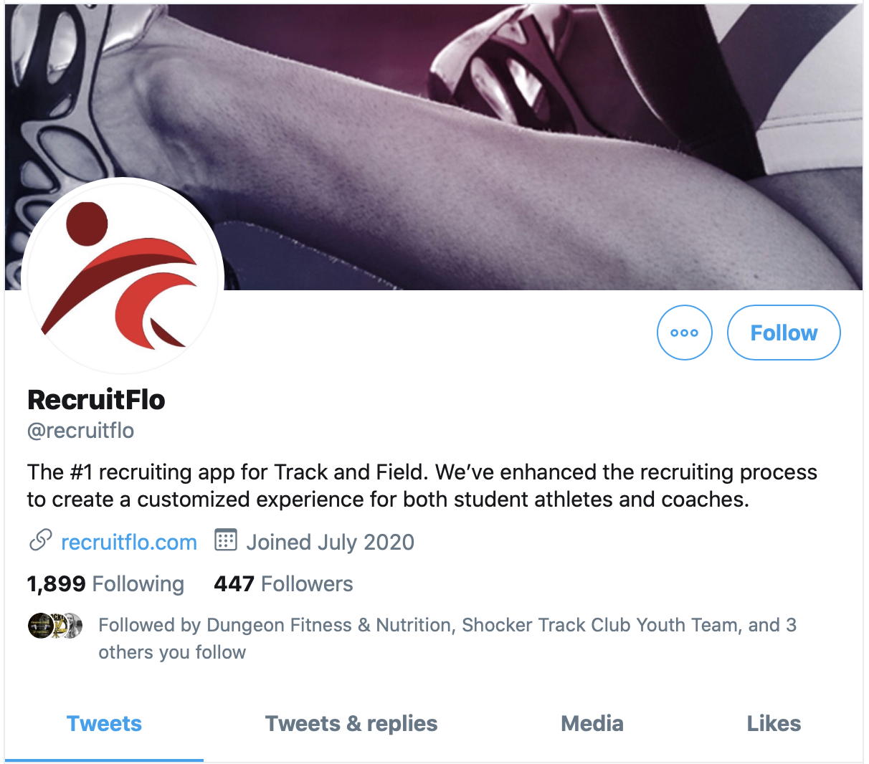
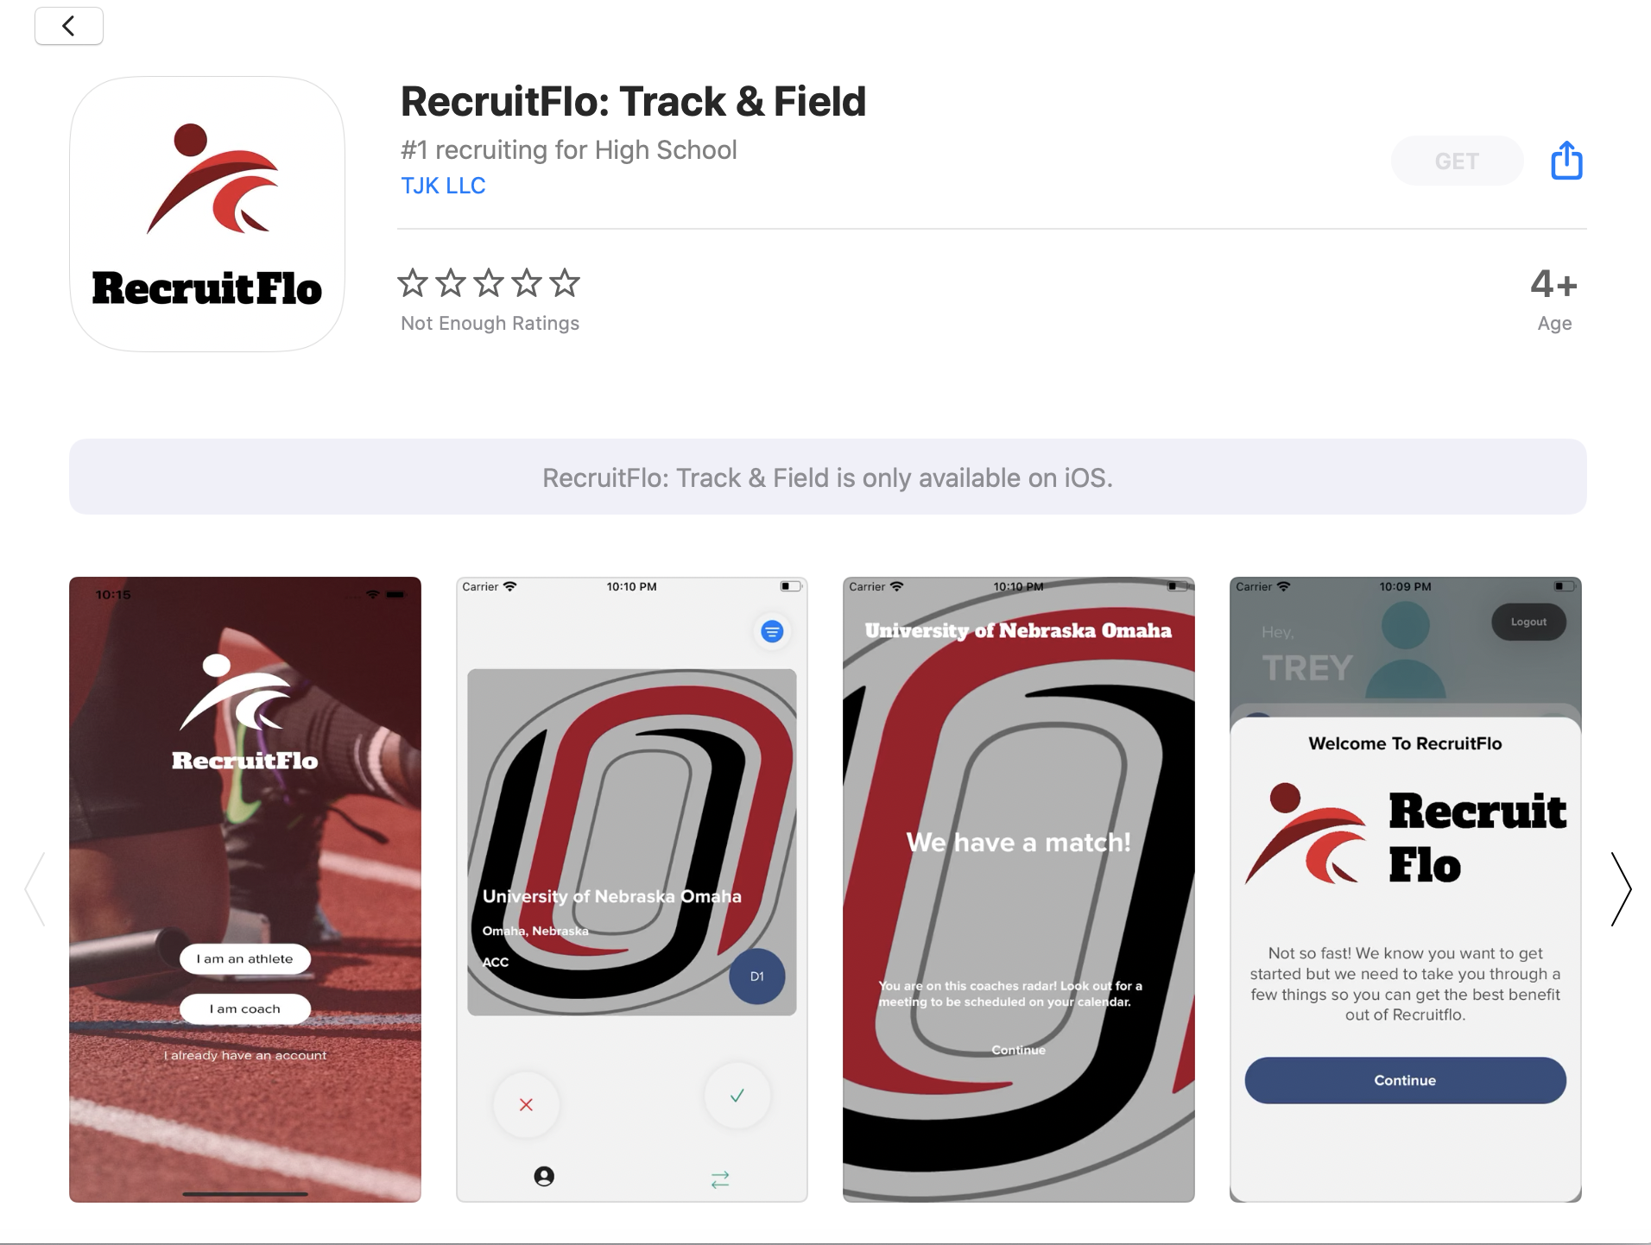
Alternate Recruiting
Application Available for Download on IOS
Available for Athletes and Collegiate Coaches
Functions like a Social Connections app
@RecruitFlo on Twitter / @recruit_flo on Instagram
RecruitFlo provides -
Connections Between Athletes and Collegiate Coaches
FREE Athlete profile and college search
General Information on every NCAA, NAIA and junior college program
Future Development -
Profiles for High School and Club Coaches -

Slide 59
Shocker Track Club
Youth Track & Field Team
The College Recruiting Process
for High School Athletes and Parents

