Slide 1

Shocker Track Club
Youth Track & Field Team
The College Recruiting Process
for High School Athletes and Parents

Slide 2
STC Recruiting Connections
Strong connections to Wichita State University, Friends University, Emporia State University, Graceland University, Army-West Point Military Academy, and Kansas State University
Presentations by Wichita State University on the college recruiting and team membership
Practice visits by various colleges and universities

Slide 3
How STC Can Assist
Mention Athlete names to colleges
Mention Athletes on social media
Provide general information about colleges
Host visits by college Coaches
Offer general opinions about various colleges

Slide 4
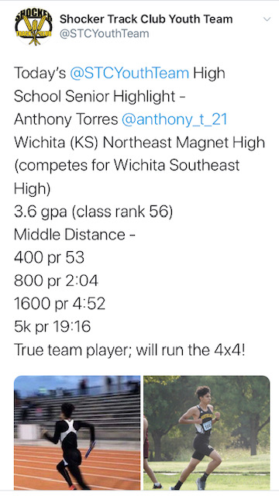
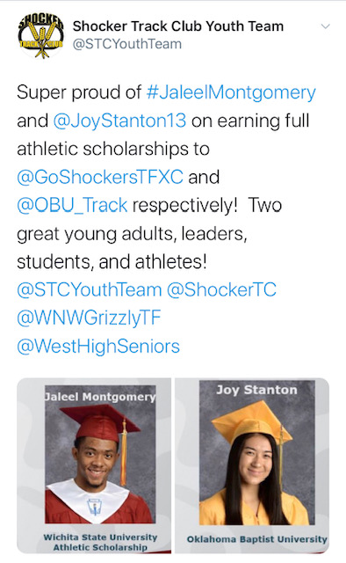
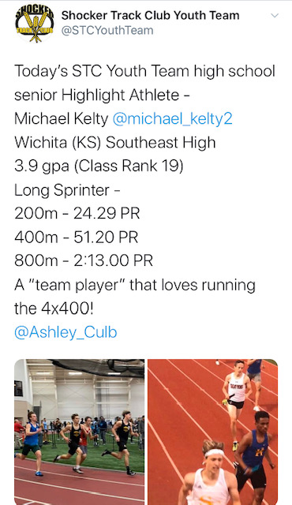
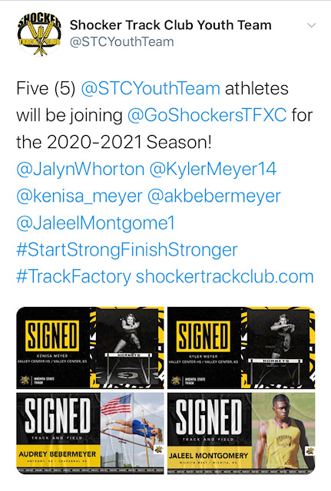
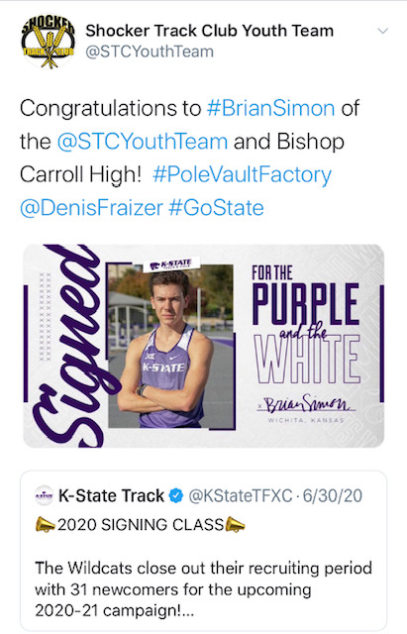
STC Social Media

Slide 5


Early Recruiting Process
Account established with NCSA – Next College Student Athlete -
NCSA is the “official recruiting partner” of USA Track & Field
Get more exposure for athletes
NCSA provides the following -
View athletes' recruiting activity, and make evaluations and recommendations
Access to virtually every college coach
Information on every NCAA, NAIA and junior college program
FREE Athlete profile and college search
Links >>
https://www.ncsasports.org/team
https://team.ncsasports.org/teams/shocker-track-club-inc/sign_up

Slide 6

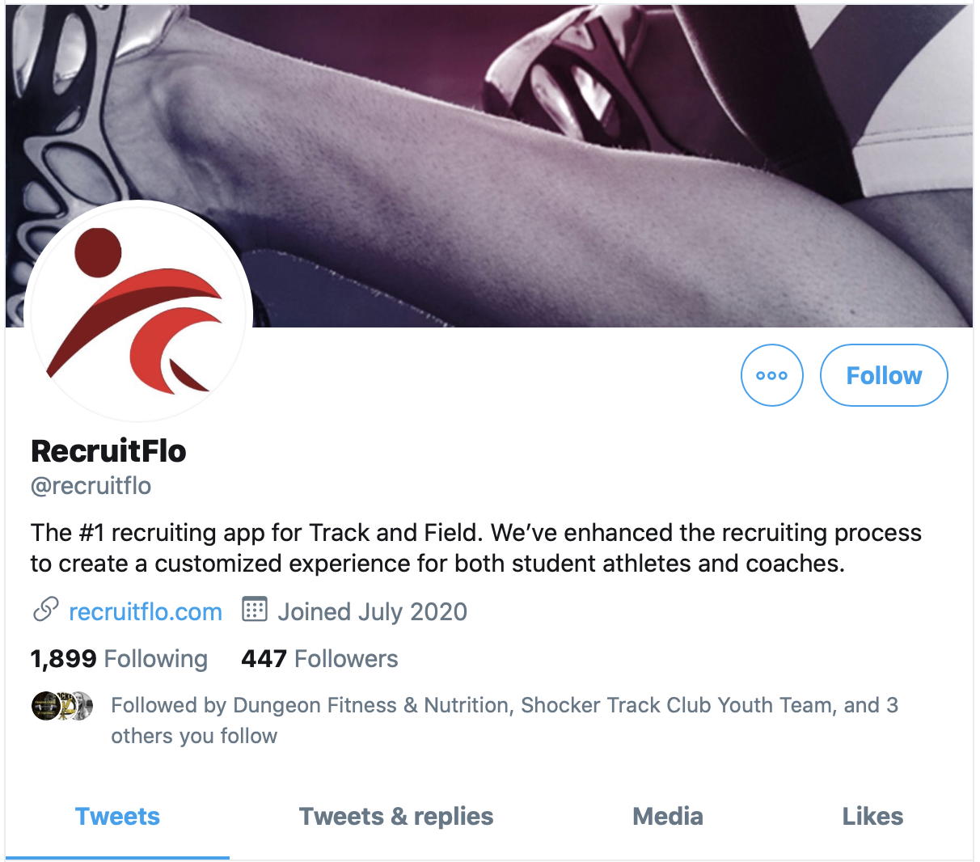
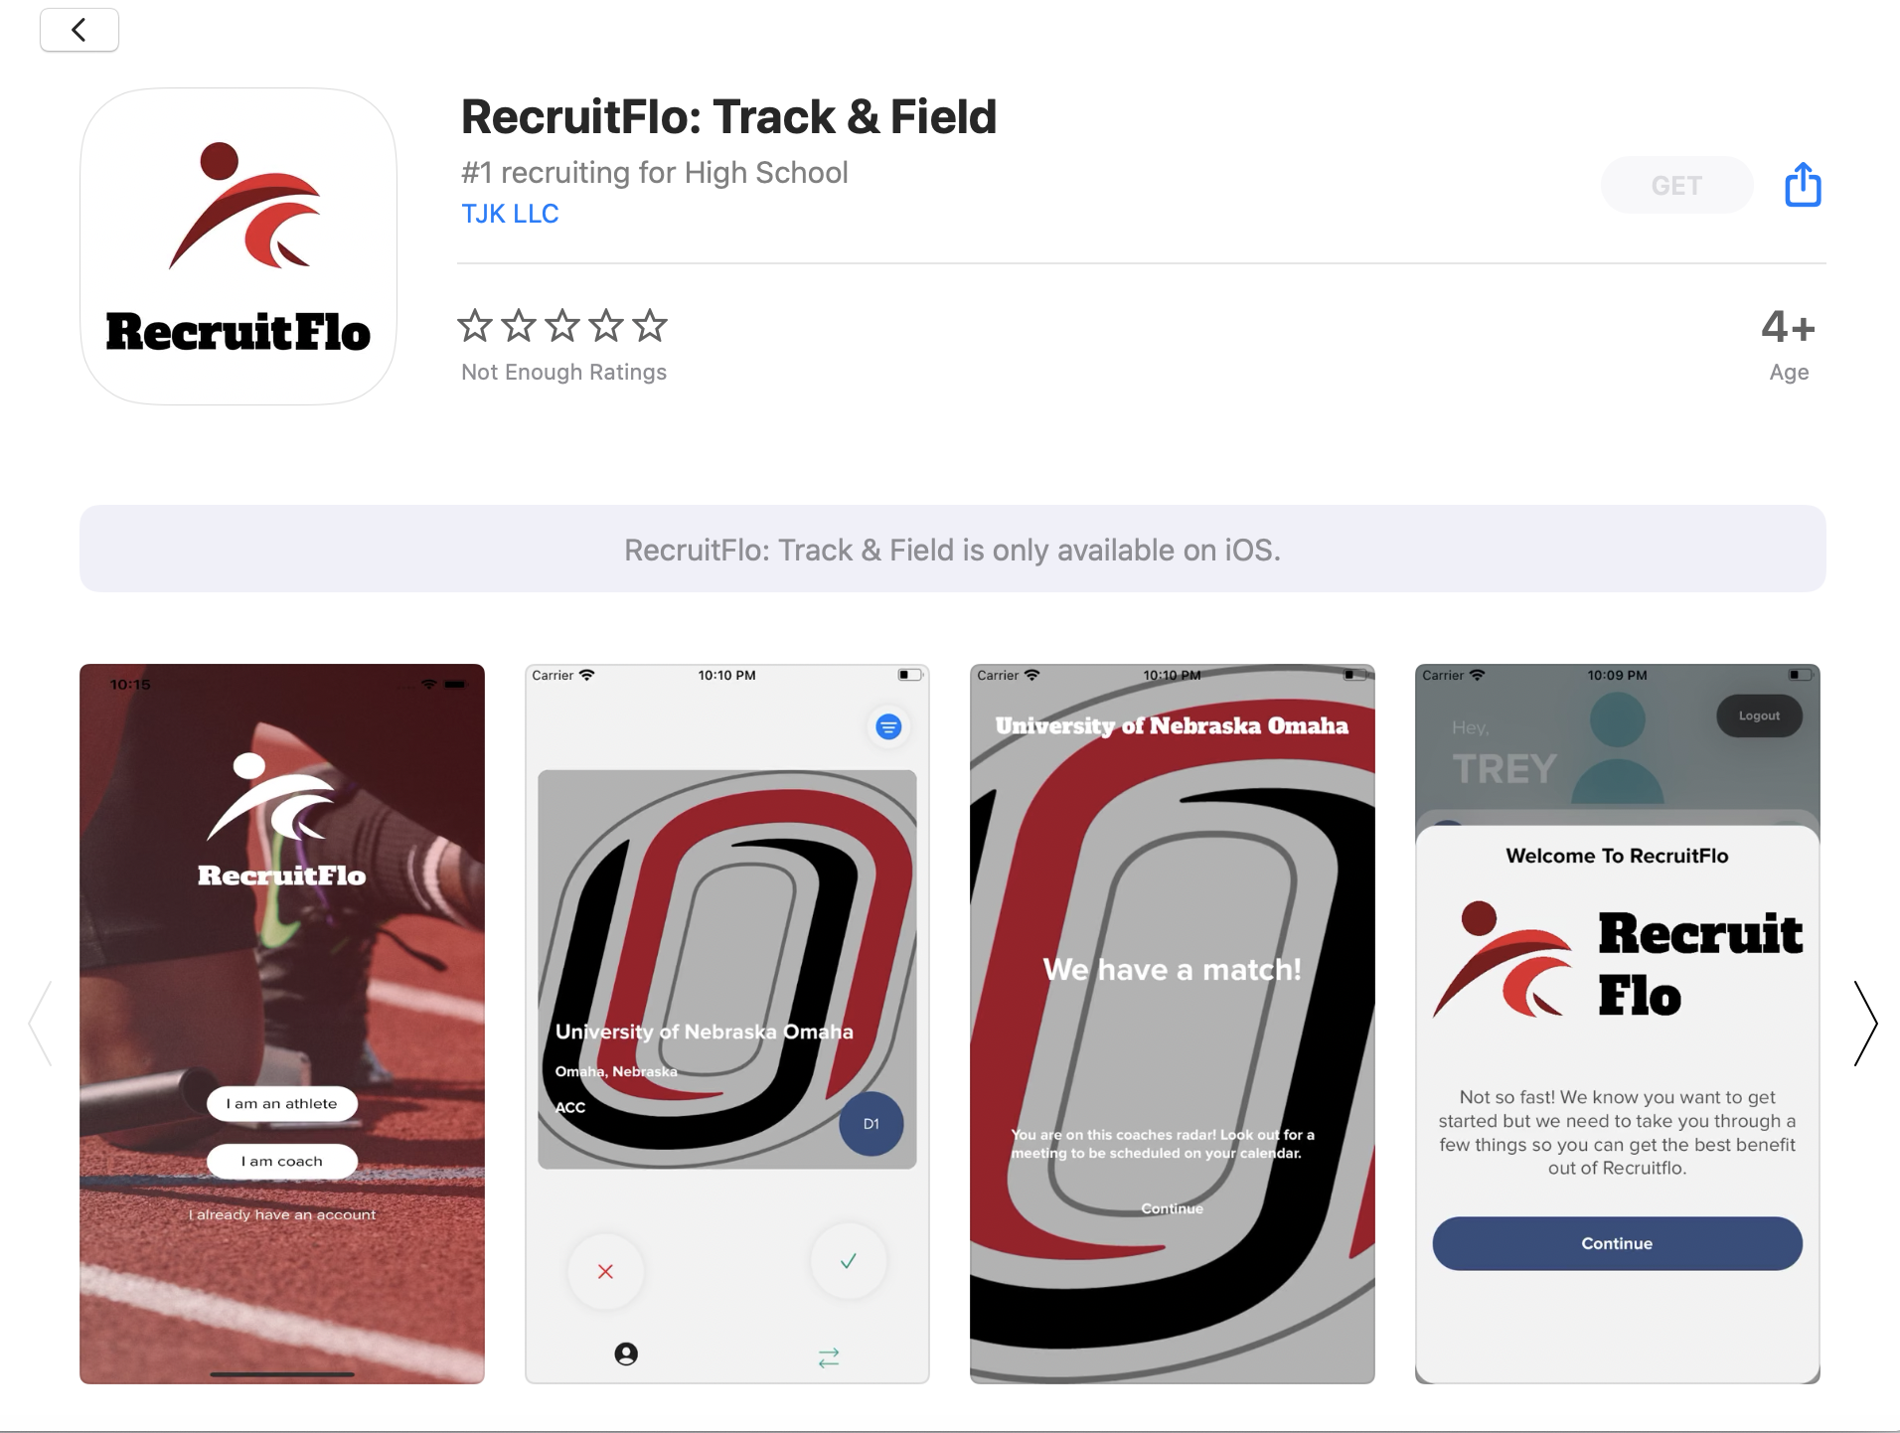
Alternate Recruiting
Application Available for Download on IOS
Available for Athletes and Collegiate Coaches
Functions like a Social Connections app
@RecruitFlo on Twitter / @recruit_flo on Instagram
RecruitFlo provides -
Connections Between Athletes and Collegiate Coaches
FREE Athlete profile and college search
General Information on every NCAA, NAIA and junior college program
Future Development -
Profiles for High School and Club Coaches -

Slide 7
STC University Connections
Indoor Track Meets
Coaching Staff
Wichita State University
  Wichita, Kansas
Pittsburg State University
  Pittsburg, Kansas
University of Kansas
  Lawrence, Kansas
Washburn University
  Topeka, Kansas
Friends University
  Wichita, Kansas
University of Missouri
  Columbia, Missouri
Wichita State University
  Wichita, Kansas
Kansas State University
  Manhattan Kansas
High Point University
  High Point, North Carolina
University of Nebraska
  Lincoln, Nebraska
Emporia State University
  Emporia, Kansas
Washburn University
  Topeka, Kansas
Pittsburg State University
  Pittsburg, Kansas
Friends University
  Wichita, Kansas
Ottawa University
  Ottawa, Kansas
West Point US Military Academy
  West Point, New York

Slide 8
Letters of Intent 2022-2023
Expected 2023 high school graduates have signed National Letters of Intent to begin competing in Fall 2023 at:
Northwest Missouri State University
Pittsburg State University
Oral Roberts University

Slide 9
Questions
?
?
?
?

Slide 10
ADDITIONAL STC CLUB INFORMATION
Shocker Track Club Youth Team

Slide 11
Letters of Intent 2022-2023
2022 high school graduates and Alum of the STC Youth Program have earned scholarships to compete this fall at:
Wichita State University (2)
University of Kansas (1)
Fort Hays State University (2)
Emporia State University (2)
Towson University (1)

Slide 12
Letters of Intent 2021-2022
2021 high school graduates and Alum of the STC Youth Program have earned scholarships to compete this fall at:
University of Louisville (1)
Emporia State University (1)
Friends University (1)
Wichita State University (1)

Slide 13
To The Future…
Former athletes in the STC Youth Program have earned scholarships (and currently compete) at:
Wichita State University (6)
Kansas State University (1)
North Texas
Louisiana-Monroe (1)
West Point – U.S. Army (3)
North Carolina A&T State
University of Kansas (2)
Fort Hays State Univ (2)
University of Colorado at Colorado Springs (1)
Emporia State Univ (5)
Bethel College
Oklahoma Baptist
Southwestern College
Fresno Pacific University
Missouri S & T University
Friends University
Washburn University

Slide 14
Letters of Intent 2020-2021
2020 high school graduates and Alum of the STC Youth Program have earned scholarships to compete this fall at:
Wichita State University (5)
Kansas State University (1)
Emporia State University (1)
Sterling College (1)
Oklahoma Baptist University (1)
Bethel College (1)
Cowley County Community College (1)
Butler County Community College (1)

Slide 15
Letters of Intent 2019-2020
2019 high school graduates and Alum of the STC Youth Program earned scholarships to compete at:
West Point – US Army Military Academy (2)
Louisiana-Monroe (1)
Emporia State University (2)
Fort Hays State University (1)
University of Colorado at Colorado Springs (1)
Southwestern College (1)
Hutchinson Community College (2)

Slide 16
STC University Contacts…
Wichita State University – Wichita KS – NCAA D1
  Steve Rainbolt – www.goshockers.com
Friends University – Wichita KS – NAIA
  Henry Brun – www.friendsathletics.com
Emporia State University – Emporia KS – NCAA D2
  Steven Blocker – www.esuhornets.com

Slide 17
RECRUITING AND COLLEGE
Shocker Track Club Youth Team

Slide 18

Education First…
Participating in college athletics is a means to an end.
What are you interested in studying in college?
What do you want to do after you graduate from college?
Colleges provide tremendous support for athletes.

Slide 19
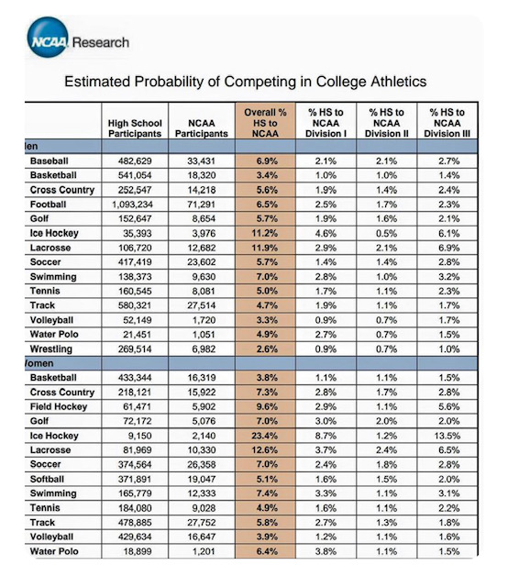
… and Last
Becoming a Collegiate Student Athlete is a Special Opportunity and a Privilege.

Slide 20
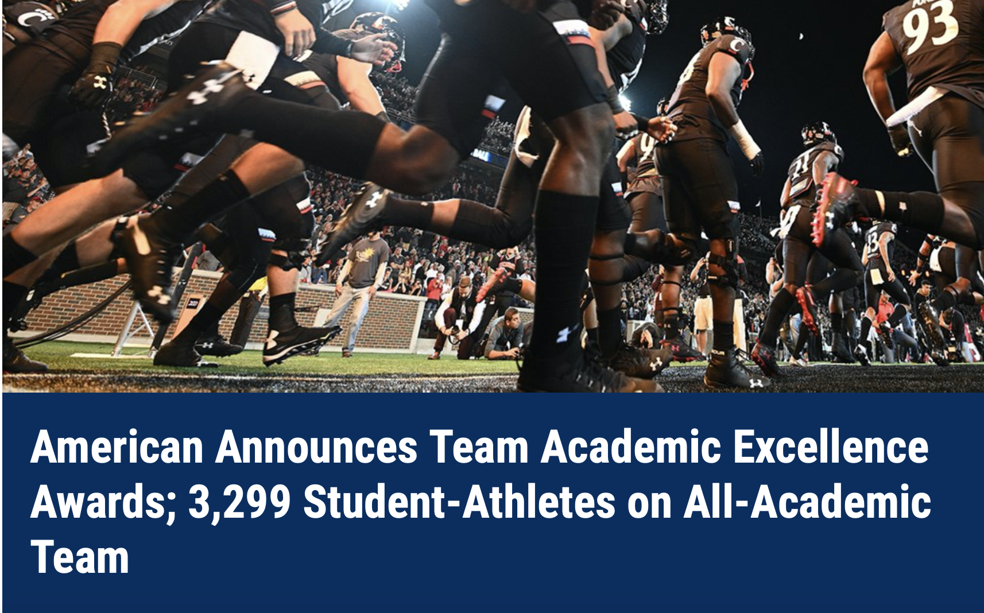
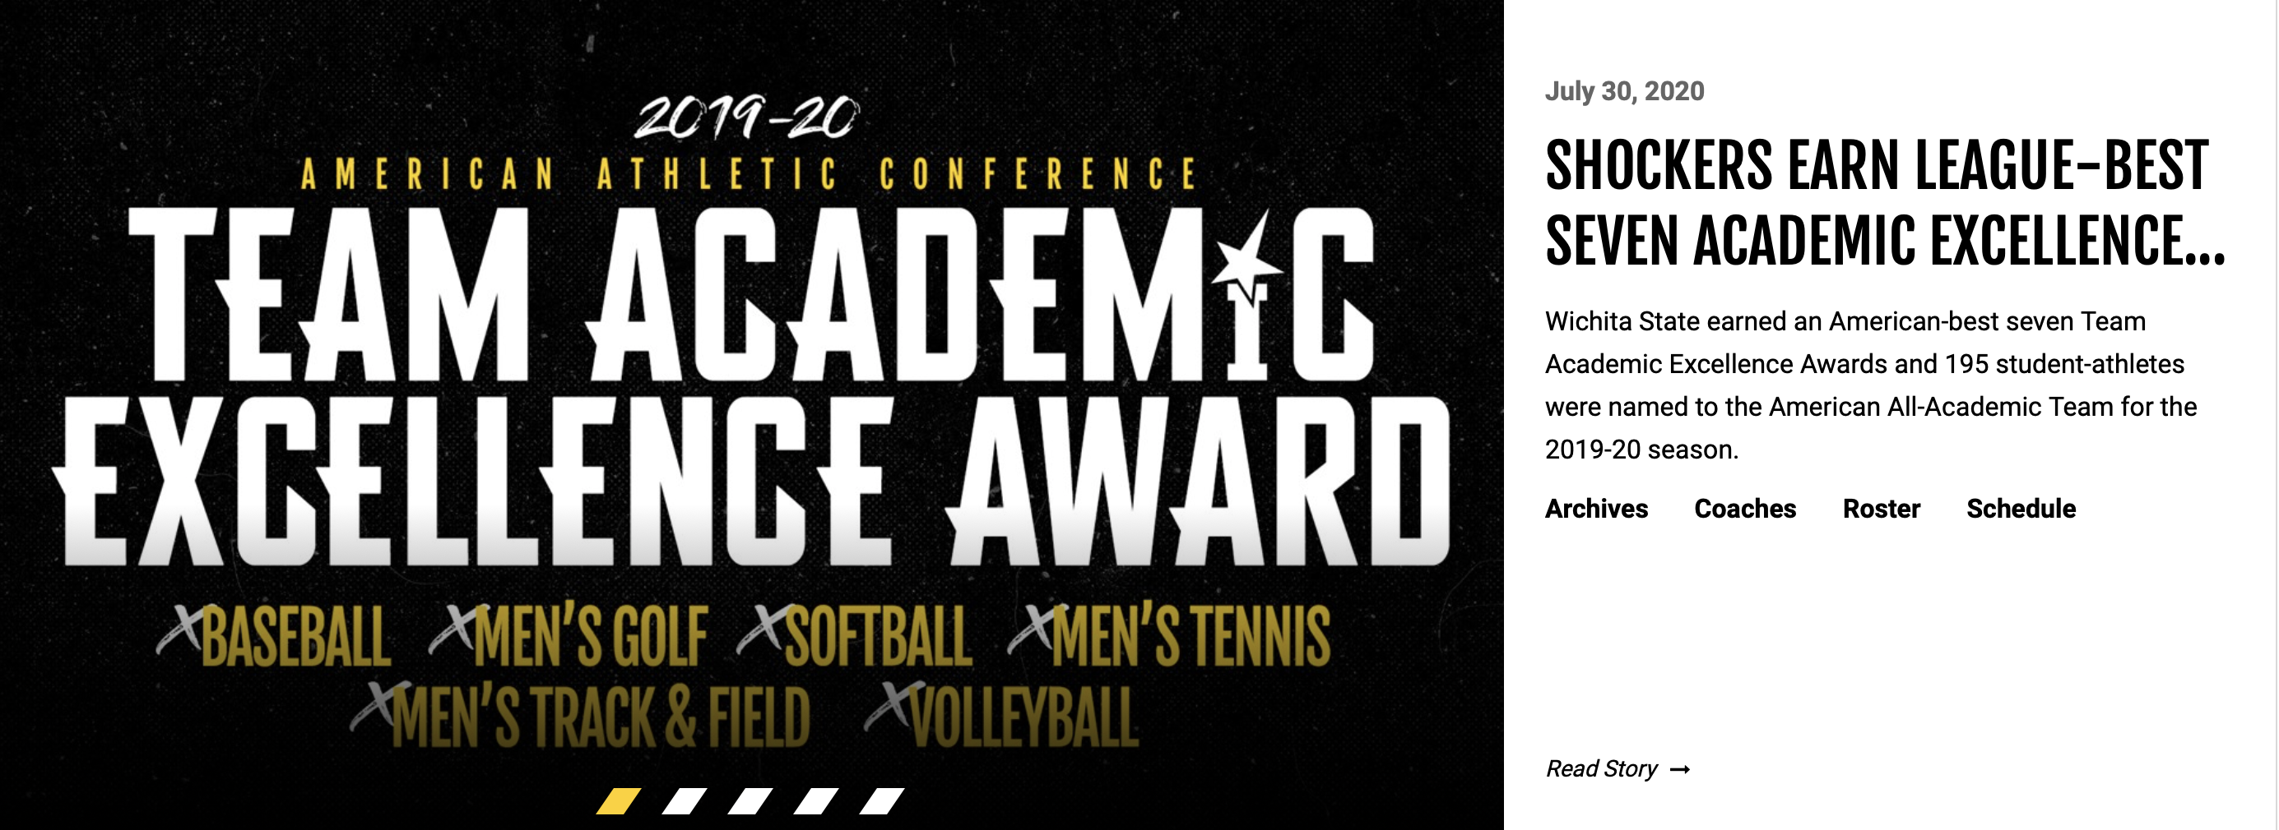
NCAA Requirements…
Colleges/Universities track academic progress of ALL athletes!
American Athletic Team Academic Excellence
Wichita State University Academic Excellence

Slide 21
Other Requirements
CollegeEligibilityRequirementsperKSHSAA

Slide 22
Things to Consider…
For colleges without football – the Track and Field Team is typically the largest athletic team on campus
Some scholarships are based upon ability to score at conference meets
Athletes competing in Track & Field AND Cross-Country sometimes earn more scholarship benefits
Redshirting can be good
NCAA D3 schools and Ivy League D1 schools do not offer athletic scholarships
Not all Track & Field athletes receive full scholarships
  Track and Field typically has 12.6 scholarships available

Slide 23
Scholarships Available…
Men’s T&F programs have fully funded -
  NCAA D1 schools have 12.6 scholarships
  NCAA D2 schools have 12.6 scholarships
  NAIA programs have 12 scholarships
Women’s T&F programs have fully funded -
  NCAA D1 schools have 18 scholarships
  NCAA D2 schools have 12.6 scholarships
  NAIA programs have 12 scholarships

Slide 24
Collegiate Athletes …
Scholarship Athletes may or typically receive –
  Tuition and Books
  Room and Board
  Meals (Training Table)
  Uniforms and Training Gear
  Training in their sport/event
  Access to Trainers
  Weight and Physical Development Training
  Study Hall and Tutoring
  Opportunities to perform community service
  Connections for the future
  Athletic knowledge base for future use

Slide 25
Collegiate Athletes …
Scholarship Athletes may or typically receive –
  Tuition and Books
  Room and Board
  Meals (Training Table)
  Training in their sport/event
  Access to Trainers
  Weight and Physical Development Training
  Study Hall and Tutoring
  Opportunities to perform community service
  Connections for the future
  Athletic knowledge base for future use
LIFE and PROFESSIONAL SKILLS!

Slide 26
Alternative Money…
Alston Educational Funds
  Up to $5980 annually
    Academic bonuses that are “rewards” for meeting academic performance goals in an amount equivalent to athletic achievement bonuses.
N(ame) I(mage) L(ikeness)….
  Collectives…
    Typically Non-Profit Organizations that facilitate programs
  University Sponsored…
    “Available” through a school’s Athletic Department
    Not all universities have them
    Opendorse is an example

Slide 27
College Coaches Look For..
Verifiable times or marks
Diversity in events
Multi-Sport Athletes
Students involved in school and community activities
“Clean” social media accounts
Great students – Leaders!

Slide 28
Athletic Standard Marks ..
Consider the following …
  Men’s -
    NCSA Men's T&F Standards by Division
  Women’s –
    NCSA Women's T&F Standards by Division
  NCAA D1 National Championship Meet Standards are considerably tougher to meet.
  Check https://www.tfrrs.org
    Current Results for Indoor and Outdoor T&F

Slide 29
Sample Standard Marks ..

Slide 30
Academic Requirements ..
In general, the following is required for admittance to a NCAA Division 1 University –
16 Core Courses -
  4 years of English
  3 years of Math (Algebra 1 or Higher)
  2 years of natural of physical science
    (including one year of lab science)
  1 year (extra) of English, Math or natural or physical science
  2 years of social science
  4 years of extra core courses
    (from any category above) or a foreign language
Minimum GPA
Standardized Test Score -
  ACT or SAT

Slide 31

What You Can Do…
Visit your high school CCC Representative
Register at NCAA Clearinghouse
Complete University Online Questionnaires
  Wichita State T&F Questionnaire
Keep Track of -
  Athletics achievements
  Classroom achievements
  Community work
Research Universities AND Athletics teams online
Follow Coaches and athletes on social media
Take visits to campuses
Send emails to college Coaches
Be Patient!

Slide 32
… and also do this…
Consider ALL Athletic Divisions
  (e.g., NCAA D1, D2, D3, NAIA, Junior College)
Have Transcripts available
Complete FAFSA
Take SAT/ACT Prep Courses
Be Patient!

Slide 33

Completing FAFSA

Slide 34
What Should Parents Do…
Plan for campus visits
Research Universities AND Athletics teams online
Make certain your child registers for the NCAA Clearinghouse
Review University Guides for Student-Athlete Parents
Review “NCAA Guide for the College Bound Student Athlete” (See Darren Muci for a Copy)
Be patient with the process
Be realistic about your child’s opportunities
Let your child ask/answer questions of Recruiters
Don’t exaggerate your child’s times/marks
Be prepared to let go at some point….

Slide 35
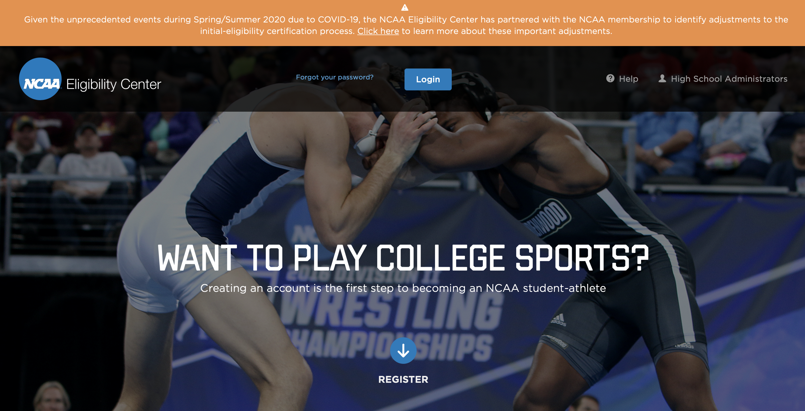
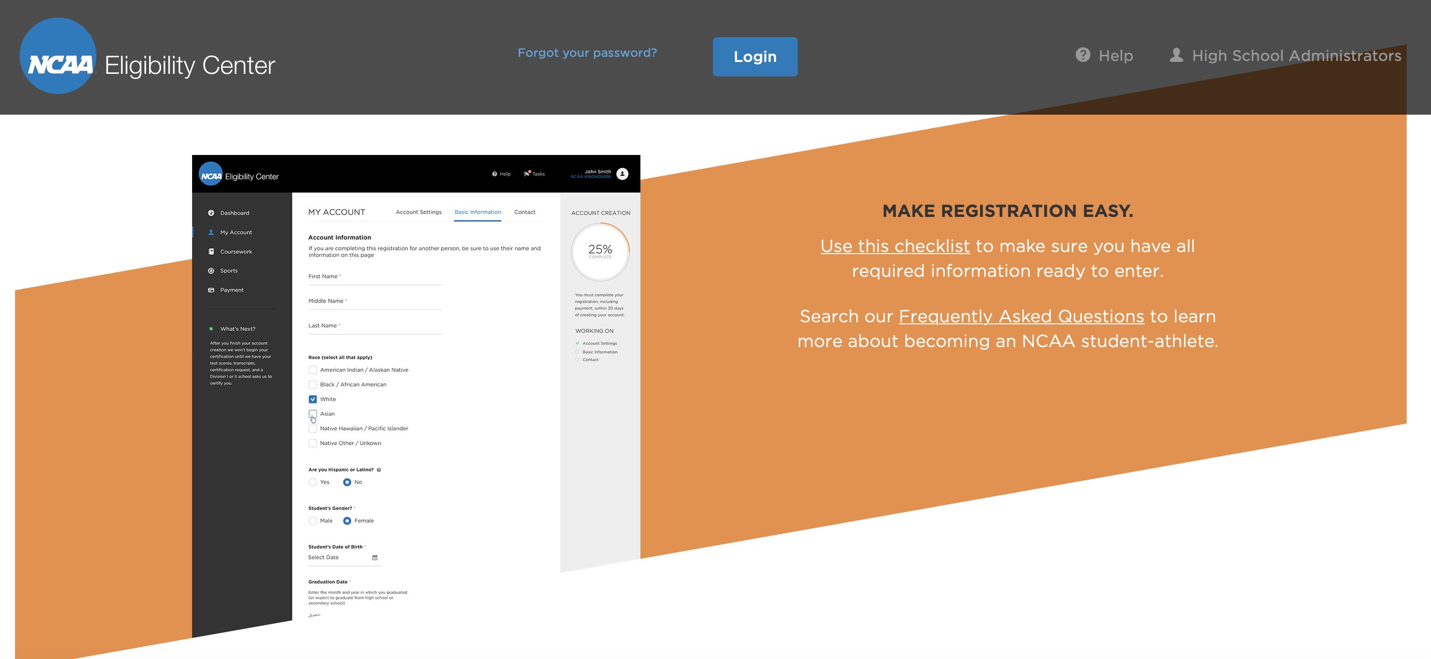
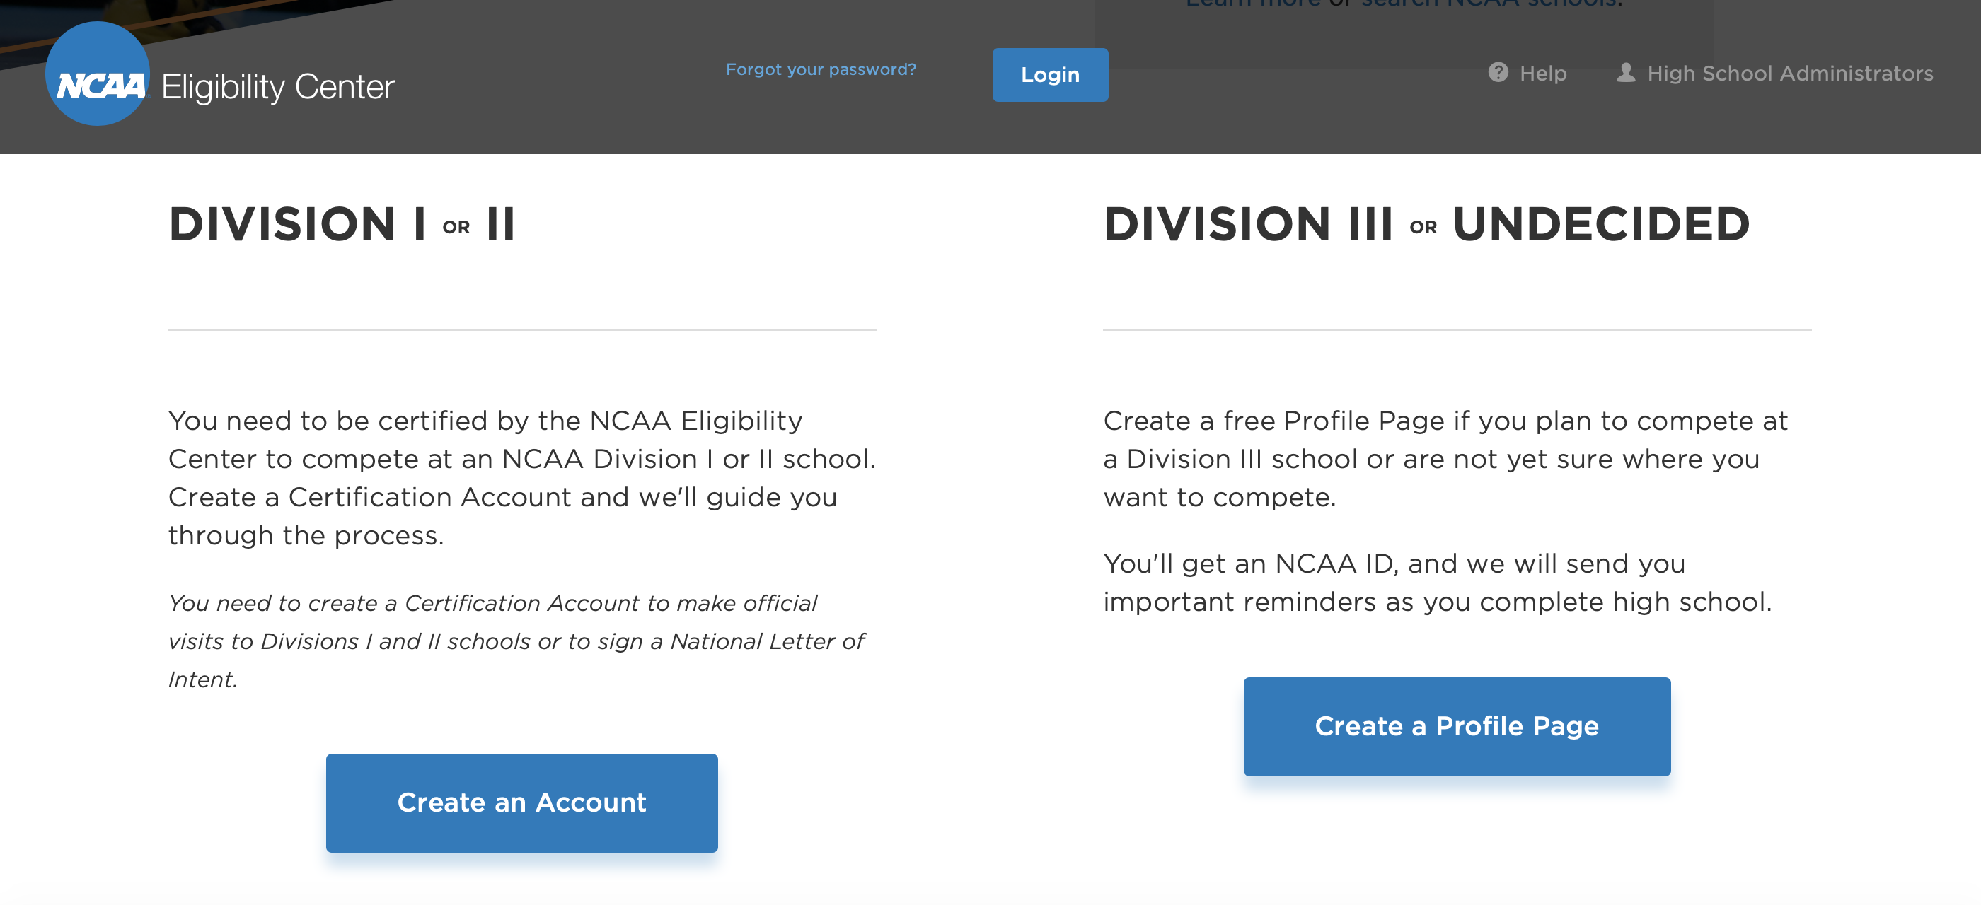
NCAA Eligibility Center
Want To Compete in Track and Field in College?
GET REGISTERED NOW!
NCAA Eligibility Center

Slide 36
Questions
?
?
?
?

Slide 37
ADDITIONAL INFORMATION
Shocker Track Club Youth Team

Slide 38
When Communicating …
Be Professional!
Use basic email address with your name or initials
Write and answer questions using “standard language” – no slang, emojis or abbreviated words
Act like you’re interested even if you don’t think that you’ll attend that school
Be mindful of posts on your social media accounts
Be considerate and thank the Coach for their time and interest
If you really don’t have interest in a school, tell the Coach and be respectful in doing so.
If a scholarship is offered, ask for details

Slide 39
Sample Email …
Hello Coach __________,
My name is _________. I’m a senior at _______High in ________, Kansas. I have also trained with the Shocker Track Club. I currently compete in Track & Field and Cross Country and I am interested in learning more about your program as I look for the best college for me beginning in 2022.
My preferred events are _________, and my PRs are ___________. I have posted videos of some of my best competitions at _________.
I currently have a x.xx grade point average, and have posted a score of XX in the ACT, and XXX for the SAT. I’m also very involved in ________, _______, and _______.
At this point I would like to major in __________.
I would appreciate the opportunity to visit with you or a member of your staff at your convenience.
Respectfully,
____________

Slide 40
Recruiting Visits…
Questions to Ask on Recruiting Visits:
Daily Athlete Schedule
Practice Time
Weightlifting Time
Competition Schedule
Athlete Retention Rate
Academic Requirements and Support
Study Hall Requirements
Travel Team Selection
Training Plans
Maintaining Scholarships

Slide 41
A Day in the Life…
Be prepared to go to work…
Up early to class
Classes
Study Hall
Team Meetings
Practice
Weightlifting
Competition
Athletic Department Activities
Community Volunteering
Eating / Sleeping / Studying
Socializing
Showcase Professional Maturity

Slide 42
Differences Between NCAA Division 1, D2, and D3
Division 1 – Typically large public and private universities with large athletic budgets
Division 2 – Typically smaller to medium-sized public and private universities with smaller budgets
Division 3 – Typically small private universities with small budgets
  NO athletic scholarships are awarded.

Slide 43
Differences Between NCAA, NAIA, and NJCAA
NCAA –
The National Collegiate Athletic Association is the most well-known college sports organization. There are three divisions of the NCAA. Divisions 1 and 2 offer scholarships; Division 3 schools do not.
NAIA –
The National Association of Intercollegiate Athletes is mostly comprised of smaller private universities. The athletic and academic standards typically aren’t as high as with the NCAA, and there are fewer rules about foreign athletes.
NJCAA –
The National Junior College Athletic Association is made up of 2-year community colleges. Community colleges are usually small and offer 2-year Associates Degrees. Because community colleges are much cheaper than large public universities, many students can attend community colleges and then transfer the course credits over to a larger university later.

Slide 44
SHOCKER TRACK CLUB OVERVIEW
Shocker Track Club Youth Team

Slide 45
SHOCKER TRACK CLUB
Mission
The Shocker Track Club, Inc., (STC) is a 501(C)(3) organization that helps support Wichita State University Track & Field and Wichita area Track and Field and Cross Country activities.

