Slide 1
SHOCKER TRACK CLUB

Slide 2
SHOCKER TRACK CLUB
Mission
The Shocker Track Club (STC) is a 501(C)(3) organization that helps support Wichita area Track and Field and Cross Country activities.

Slide 3
STC Organizational Structure
Board of Directors
Executive Committee
Elite Team
Masters/Open Team
Youth Team
Officials/Volunteers
Finance
Membership
Uniforms/Gear
Futurist
Communications
Fund Raising
Founded in 2011
501(C)(3) in 2013
Supports WSU Track & Field
Officials & Volunteers
Athletics Teams
Elite
Masters/Open
Youth

Slide 4
STC Board of Directors
Officers & Chairs
Members
Darren Muci, President
Chris Ellis, Vice President
Chandra Andrews, Treasurer
Larry Staton, Secretary
Steve Rainbolt, WSU Head Coach
John Wise, WSU Asst Head Coach
Sam Garrison, Membership
Laura Markuly, Futurist
Grant Overstake, Communications
Jerry Proffitt, Officials/Volunteers
Heidi Yost, Uniforms & Gear
Dylan Hartnett, Elite Team
Patrick Simon, Youth Team
Larry Staton, Masters/Open
Emily Green Maier
Vic Everett
Bill Faflick
Mike Holladay
Audacia Moore
Brian Hargrove
Jeff Boleski
David Morris
Michael Draut
Amber McGown
Dylan Schmidt
Darius Draudvila, Ex Officio
TJ Arant, Ex Officio

Slide 5
Follow STC …
www.shockertrackclub.com
Facebook
Facebook – Youth Team
Twitter - @ShockerTC

Slide 6
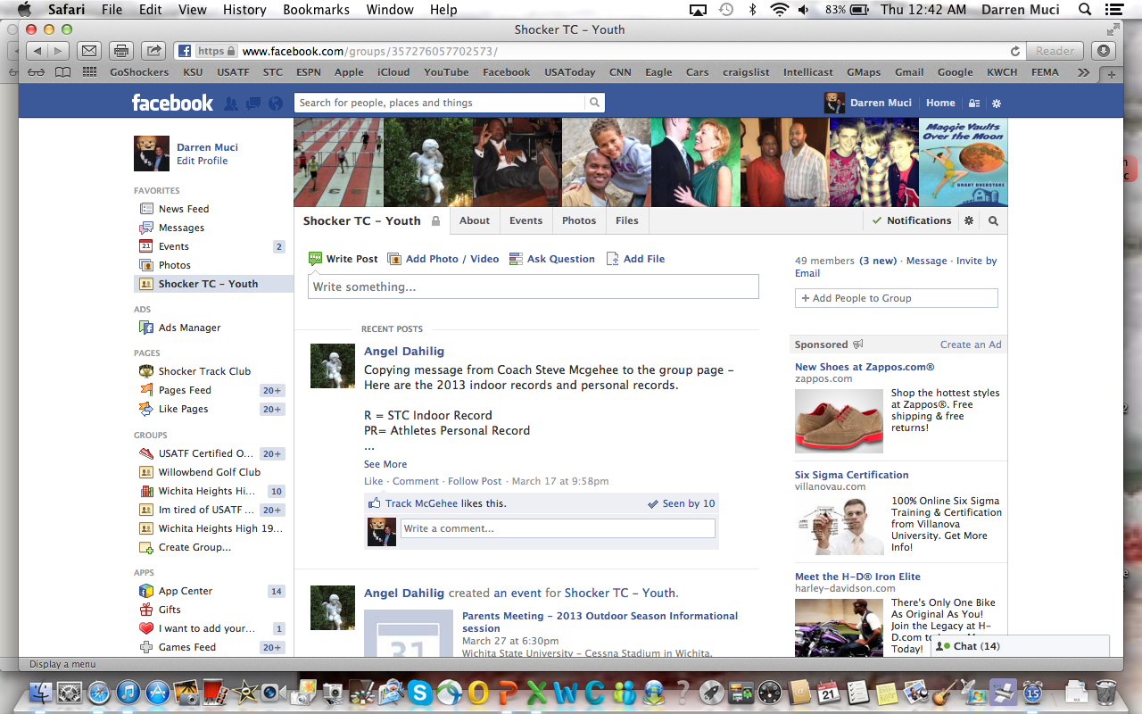
Follow STC via Social Media

Slide 7
STC Membership Structure
Individual -
Business -
$50 All-Conference
$100 All-American
$250 Bronze
$500 Silver
$1000 Gold
$1500 Platinum
$250 Yellow
$500 Black
Payment options are available!
Fees are tax deductible less the value of any benefits

Slide 8
STC Business Members
Ergonomic Solutions
Kanai Sushi
First Gear
Go Run!
GMLS Industries
Lubbers Cars

Slide 9
STC Memberships Support…
Uniforms for Elite and Youth Athletes
Practice time for Youth Team
Shirts for Certified Officials and Volunteers
Operational expenses

Slide 10
STC Sponsorships Available…
Full Uniform Components for Elite & Youth Team
Travel Expenses for Elite & Youth Team
Meet registration fees for Elite and Youth Athletes
Training materials and equipment

Slide 11
2013 Looking Forward…
Strong Elite Team
Expanding Youth Team
Expanding Masters/Open Team
More Certified Officials & Volunteers
WSU Student “CREW” Volunteer Squad
Four STC Track Meets – USATF sanctioned
FAT at all STC sanctioned meets
Participation in USA Track & Field National Championship meet in Des Moines

Slide 12
Get Involved!
STC Membership
Purchase STC Club T-Shirts
Help with STC Meets
Youth Team Season Scrapbook
Plan Team Celebrations!
STC Sponsorships
Wichita State Track & Field Meets Volunteers
Youth and Adults can help!
Saturday, April 13th KT Woodman Track Classic
Saturday, April 20th Track-It Buster Invitational

Slide 13
Questions
?
?
?
?

Slide 14
Shocker Track Club
Youth Team – Summer 2013

Slide 15
Youth Team - Vision
The Shocker Track Club Youth Team operates under the auspices of the Shocker Track Club Board of Directors.
The Youth Team goal is to provide opportunities for interested youth to compete in track and field from an introductory level, to high-level competition under the framework of USATF guidelines.
Experienced and certified coaches provide appropriate guidance and leadership. Separate indoor and outdoor seasons provide opportunities for nearly six months of training.

Slide 16
Youth Team Leadership
Youth Team Leadership –
Patrick Simon Director and Head Coach
Steve McGehee Assistant Director and Coach
Angel Dahilig Team Mom
Jody Klein Marketing
Assistant Coaches (TBD)

Slide 17
Coaches and Volunteers
All STC Youth Coaches AND Volunteers MUST:
Be USATF members
$30 annual membership
Have passed a USA Track & Field background check
This includes parents/guardians that want to assist their own children during official practices.
www.usatf.org
Shocker Track Club is USATF Club Number is 28-4080

Slide 18
Parents/Guadians
Parents are important to the success of the athlete and the track club.
Please observe the following:
Maintain a positive attitude
Pay all fees in a timely manner
Realize that once an athlete is at a given facility, they are under the supervision/jurisdiction/guidelines of the STC Youth Team management and coaching staff
Ensure that the athlete is at practice and at meets on time
Remain in the seating area at practice and meets
Ask questions of STC Youth management and coaches at an appropriate time and in an appropriate manner

Slide 19
Youth Practices
WSU Cessna Stadium –
April 16 through May 21
Tuesdays and Thursdays
630p to 800p
May 27 through July 17
Monday, Tuesday and Wednesday
630p to 800p
Alternate locations with notice -
Andover YMCA
Plainview Park

Slide 20
STC Home Youth Meets
WSU Cessna Stadium -
Shocker Track & Field Summer Series (Thursday Night Track Meets)
May 30 through July 18
Saturday, May 17 and/or June 15, 2013*
Saturday, July 13, 2013*
* USATF Sanctioned

Slide 21
Shocker Track Club
USATF Affiliation

Slide 22
Affiliation
USA Track and Field
Missouri Valley Association
Club No. 28-4080

Slide 23
USATF Youth Membership
STC purchases memberships using personal information for each youth athlete. This includes address, phone number(s), email address, and parent/guardian contact.
To verify an athlete’s date-of-birth, parents will forward a scanned copy of the athlete’s birth certificate to membership@usatf.org.
USA Track & Field will contact youth members directly to provide important membership information.
USA Track & Field must be able to get in touch directly with the household/parents of our youth athletes. The USA Track & Field privacy statement requires this information for every member.

Slide 24
USATF Membership Benefits
10% discount in the USATF Online Store
Subscription to Fast Forward magazine
Access to exclusive members only news items
Access to enter exclusive members-only contests
Sports accident insurance
Special discounts and offers from over 25 companies
Discount tickets to USATF events

Slide 25
Shocker Track Club
Youth Programs – Summer 2013

Slide 26
Developmental
Ages 6-16 – ($100 per season)
Group focuses on basic training and instruction of the three disciplines within track and field (running, jumping, throwing) on basic training and fitness, not competition.
Fee includes:
USATF membership
Coaching
Team T-shirt
Practice time at WSU Cessna Stadium
Meet fees for Shocker Track & Field Summer Series meets at WSU Cessna Stadium

Slide 27
Competition
Ages 8-18 – ($225 per season)
($100 returning athletes from indoor season)
Group focuses on taking competitive skills to the next level – going from good to great, from great to excellent, from excellent to superior! Group will participate in meets focusing on state and regional competition within USA Track & Field.
Fee includes:
USATF membership
Coaching
Team Uniform (singlet, shorts, t-shirt, warm-up suit)
Practice time at WSU Cessna Stadium
Meet fees for Shocker Track & Field Summer Series June/July Thursday night track meets at WSU Cessna Stadium
Meet day hydration and snacks

Slide 28
Elite
Ages 14-19 – ($310 per season)
Group focuses on developing a particular skill set of advanced athletes with the plan on qualifying for a national team on the youth and/or junior national level.
Fee includes:
USATF membership
Personal Coaching
Team Uniform (singlet, shorts, t-shirt, warm-up suit)
Practice time at WSU Cessna Stadium
Meet fees for Shocker Track & Field Summer Series Thursday night track meets at WSU Cessna Stadium
Meet day hydration and snacks
Registration fees to national meets

Slide 29
Coach Bio
Patrick Simon
As an athlete
Began in 1987 running track in middle school & ran through college
Part of Chicago League Championship teams
Qualified/participated in state championships
Ran college track on scholarship (team placed fourth at Nationals in 1993 & 1994)
USATF Coaching Education
Level 1 Certified in 2000
Level 2 Certified in 2001
Jumps, Sprints, Hurdles, and Relays
Regularly attended IHSA & USATF Clinics
Led/Conducted Clinics for the Chicago Public Schools for several years

Slide 30
Coach Bio
Patrick Simon
Began coaching in 2000
Coached numerous Association and Regional champions and qualifiers
Coached several national champions, national runner-ups, in addition to All-Americans from the 100m to the Heptathlon
Served as a personal coach for 2010 Junior World Championships
Helped coach 2 time national champion in 100m
Been an official at:
Division III National Championships (comb events co.)
USATF J.O. (starter / comb events co.)
Kansas Relays
Junior College National Championships (comb events co.)
Big 12 Championships (comb events)

Slide 31
Patrick Simon Bio Continued…
Marks that I have coached/officiated:
Men:
100 – 10.03
200 – 21.24
400 – 46.16
800 – 1:48.24
4x100 – 41.60
LJ – 26’8”
TJ – 54’3”
HJ – 7’3”
SP – 53’4”
Discus – 135’8”
Decathlon – 7642 pts.

Slide 32
Patrick Simon Bio Continued…
Marks that I have coached/officiated:
Women:
100 – 11.01
200 – 22.77
400 – 51.01
800 – 2:06
4x1 – 42.99
LJ – 21’1”
TJ – 40’1”
HJ – 6’1”
JAV (HS) – 100’ (IL HS Record)
Heptathlon – 5600+

Slide 33
Coach Bio
Steve McGehee
Ran college track on scholarship (team placed fourth at Nationals in 1993 & 1994)
20 years experience
During 2012 season took 28 athletes – competing in 35 events – to the Youth Junior National meet.

Slide 34
Coaching Philosophy
The Youth Team goal is to provide opportunities for interested youth to compete in track and field from an introductory level, to high-level competition under the framework of USATF guidelines.
We do not coach wins or losses, but keep athletes focused on improving their PRs.

Slide 35
Youth Meets
See handout

Slide 36
Questions
?
?
?
?

