Slide 1
Shocker Track Club
Youth Team – Spring/Summer Outdoor 2015

Slide 2
Youth Team – Mission
Provide opportunities for youth to compete in track and field from an introductory level, to high-level competition, under the framework of USATF guidelines.

Slide 3
Youth Team Leadership
Cole Davis Director
Shamoya Pruitt Assistant Director
Anita Curtis Team Mom
Curtis Hernandez Head Coach
Darren Muci President, STC

Slide 4
Fee Structure
Join in April $190
Join in May $175
Join in June/July $125
Fee includes:
Coaching and Practice Time at WSU Cessna Stadium
Team T-shirt
Participation in WSU Summer Series Thursday Night Track Meets

Slide 5
Youth Practices
WSU Cessna Stadium
April 21 through April 30
Tuesday and Thursday
600p to 700p
May 5 through May 28
Tuesday, Wednesday and Thursday
645p to 815p
June 1 through July 29
Monday, Tuesday, and Wednesday
645p to 815p
Alternate locations with notice

Slide 6
Leaders and Coaches
All STC Youth Leadership and Coaches MUST:
Have applied to Shocker Track Club
Be USATF members
$30 annual membership
Have passed a USA Track & Field background check
$8 fee
The above applies to parents/guardians that want to assist their own children during official practices.

Slide 7
Youth Team Coaches
Curtis Hernandez Distance
Shamoya Pruitt Sprints/Hurdles
Denis Fraizer Pole Vault
Skyler Arneson Throws
Shazz Michael-Lindo Horizontal Jumps
Anita Curtis Distance
Donna Hernandez Distance

Slide 8
Coaching Philosophy
Oversight, Coaching, and Support
is performed in a way that:
provides opportunities for participating youth to have fun,
provides opportunities for youth to improve as track and field athletes, and
teaches youth to set goals and develop character through sportsmanship,

Slide 9
Parents/Guardians
Parents are important to the success of the athlete and the ShockerTrack Club.
Please observe the following:
Maintain a positive attitude
Pay all fees in a timely manner
Realize that once an athlete is at a given facility, they are under the supervision/jurisdiction/guidelines of the STC Youth Team management and coaching staff
Ensure that the athlete is at practice and at meets on time
Remain in the seating area at practice and meets
Ask questions of STC Youth management and coaches at an appropriate time and in an appropriate manner

Slide 10
USATF Youth Membership
Shocker Track Club is a USATF Certified Club
Parents/Guardians MUST purchase a USATF or AAU membership for their child if they wish for their child to participate in USATF and AAU championship-track meets
www.usatf.org
www.aausports.org

Slide 11
USATF Membership Benefits
10% discount in the USATF Online Store
Subscription to Fast Forward magazine
Exclusive members only news items
Exclusive members-only contests
Sports accident insurance
Special shopping discounts and offers
Discount tickets to USATF events

Slide 12
Questions
?
?
?
?

Slide 13
SHOCKER TRACK CLUB
Mission
The Shocker Track Club, Inc., (STC) is a 501(C)(3) organization that helps support Wichita area Track and Field and Cross Country activities.

Slide 14
Shocker Track Club
USA Track & Field Affiliation
Missouri Valley Association
Club No. 28-4080

Slide 15
History
Wichita State University Track and Field Director, Steve Rainbolt, and Assistant Head Track Coach, John Wise developed the Shocker Track Club concept in 2010. Longtime USATF official Darren Muci was approached about leading an initiative to form a track club that would:
(1) Provide USATF meet planning, and certified officials and volunteers, for Wichita State University Track & Field and Cross Country meets,
(2) Help raise funds to support local track and field initiatives, and,
(3) Help develop and support Elite, Masters/Open, and Youth track teams.

Slide 16
STC Organizational Structure
Board of Directors
Executive Committee
Elite Team
Masters/Open Team
Youth Team
Officials/Volunteers
Finance
Membership
Communications
Fund Raising
Founded in 2011
501(C)(3) in 2013
Supports WSU Track & Field
Officials & Volunteers
Athletics Teams
Elite
Masters/Open
Youth

Slide 17
STC Board of Directors
Officers & Chairs
Members
Darren Muci, President
Chris Ellis, Vice President
Ryan Patton, Treasurer
Larry Staton, Secretary
Steve Rainbolt, WSU Head Coach
John Wise, WSU Asst Head Coach
Natalie Morerod, Sponsorships
Laura Markuly, Fundraising
VACANT, Communications
Vic Everett, Officials/Volunteers
Dylan Hartnett, Elite Team
Cole Davis, Youth Team
Larry Staton, Masters/Open
Michael Draut
Bill Faflick
Curtis Hernandez
Amber McGown
Emily Green Maier
J Means
Shamoya Pruitt
Mark Schwarm
Patrick Simon
Damian Smithhisler
Darius Draudvila, Ex Officio
Joan Hearne, Ex Officio

Slide 18
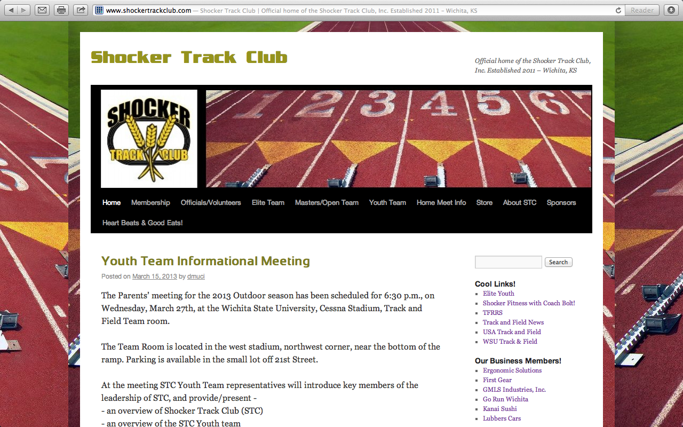
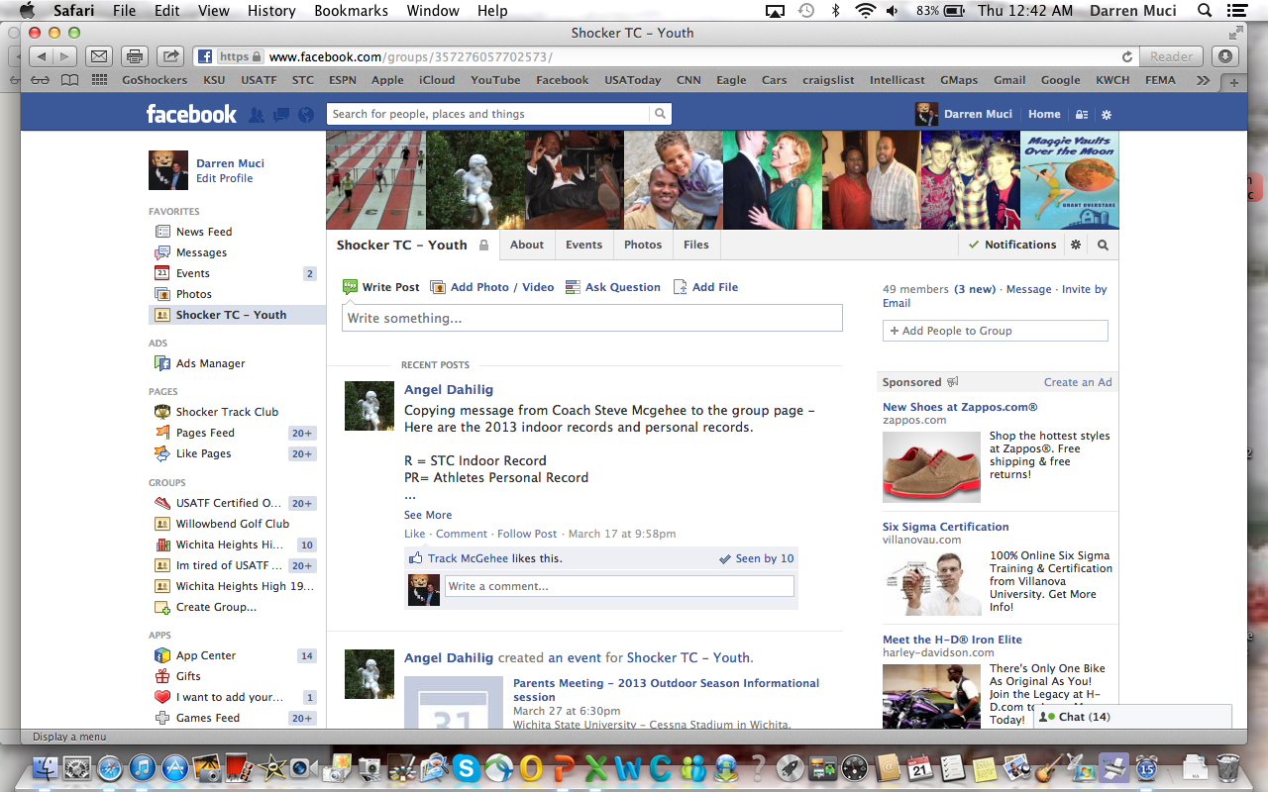
Follow STC …
www.shockertrackclub.com
Facebook – Shocker Track Club
Twitter - @ShockerTC
Facebook – Youth Team
Twitter - @YouthShockerTC

